Slide 1
Introduction to Computing for Data Analysis
Logistic regression (classification)
Richard Vuduc, Ph.D.
Associate Professor
School of Computational Science and Engineering
Applying MLE to logistic regression
Notes:
Great, you are back.
You’ve been looking at several important building blocks, like the ideas of linear discriminants and soft labels using the logistic function.
In this lesson, I want you to put these pieces together, specifically by applying maximum likelihood estimation to the logistic classifier model.

Slide 2
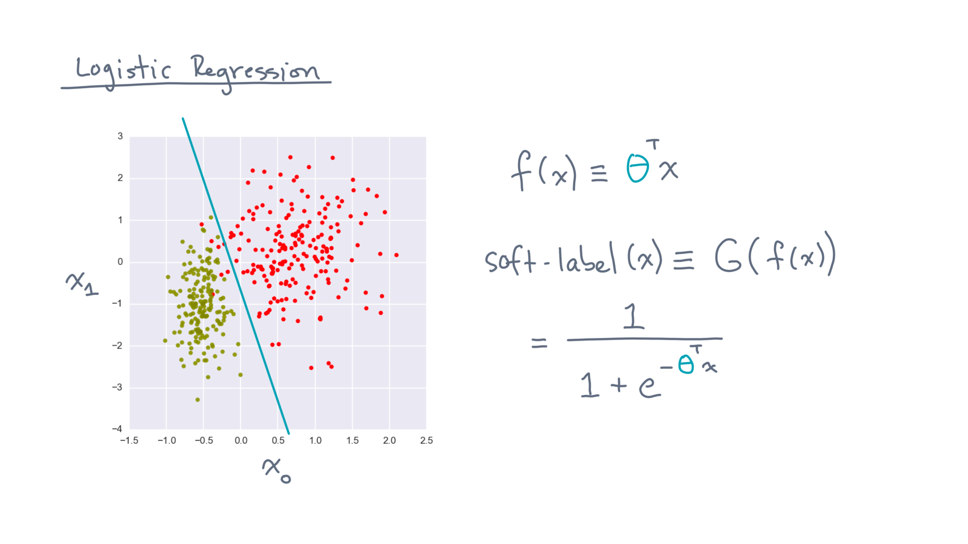
Notes:
As a quick reminder, we are trying to fit a model to a set of labeled data.
This model has two components.

Slide 3
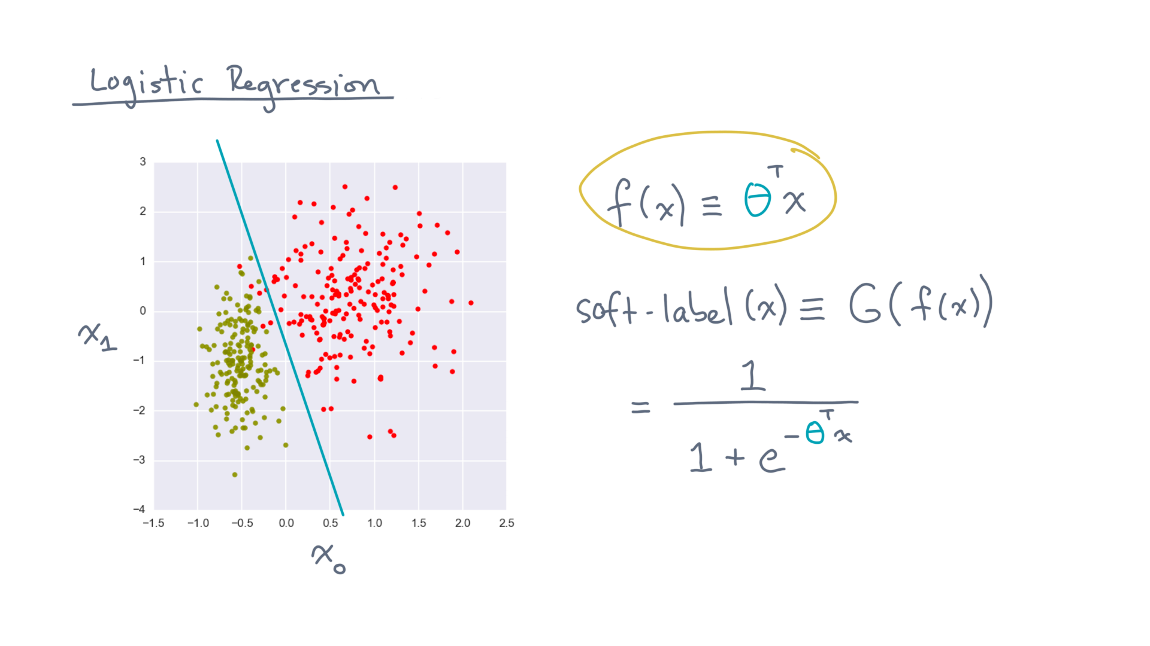
Notes:
The first is a scoring function, that assigns a value to every point in space.

Slide 4
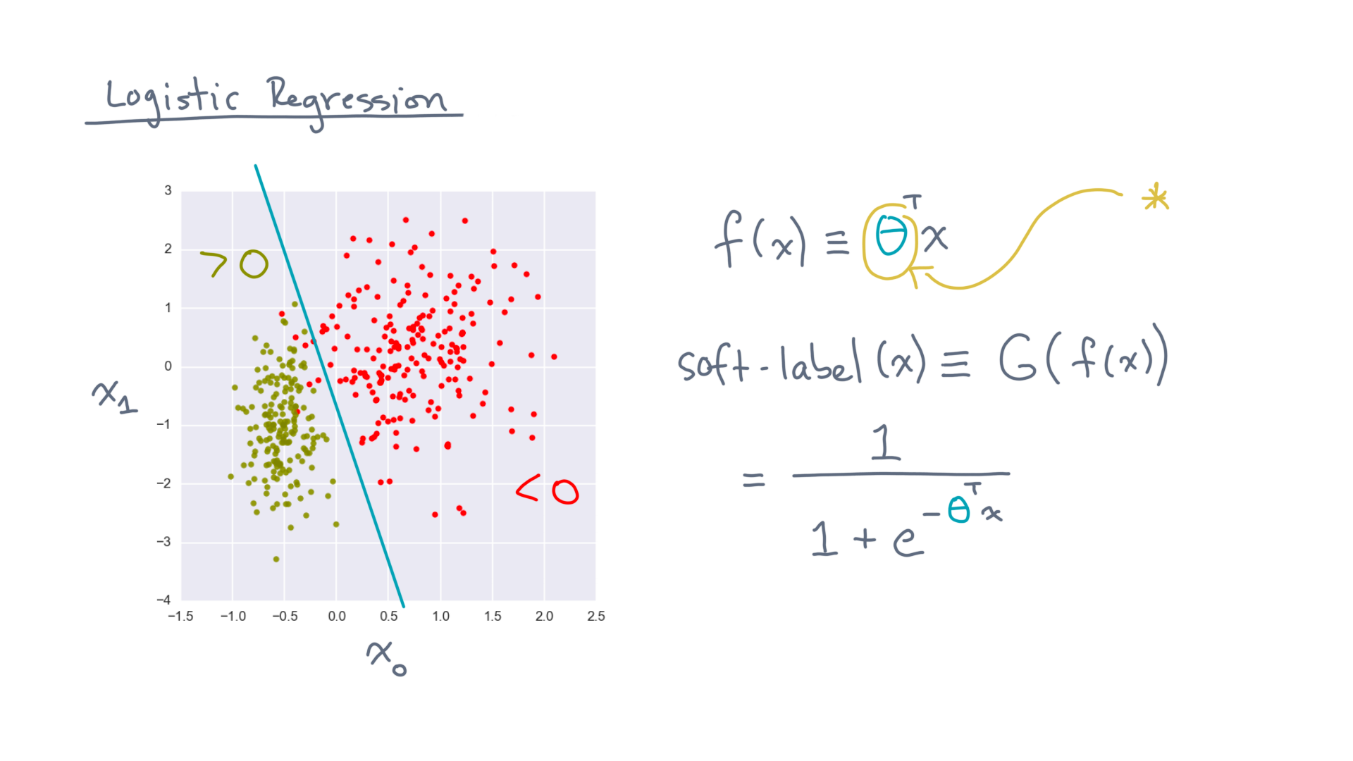
Notes:
We happened to pick a linear function, which is often a good place to start.
The specific choice of theta determines a “separating boundary,” or “discriminant, between positive and negative values.

Slide 5
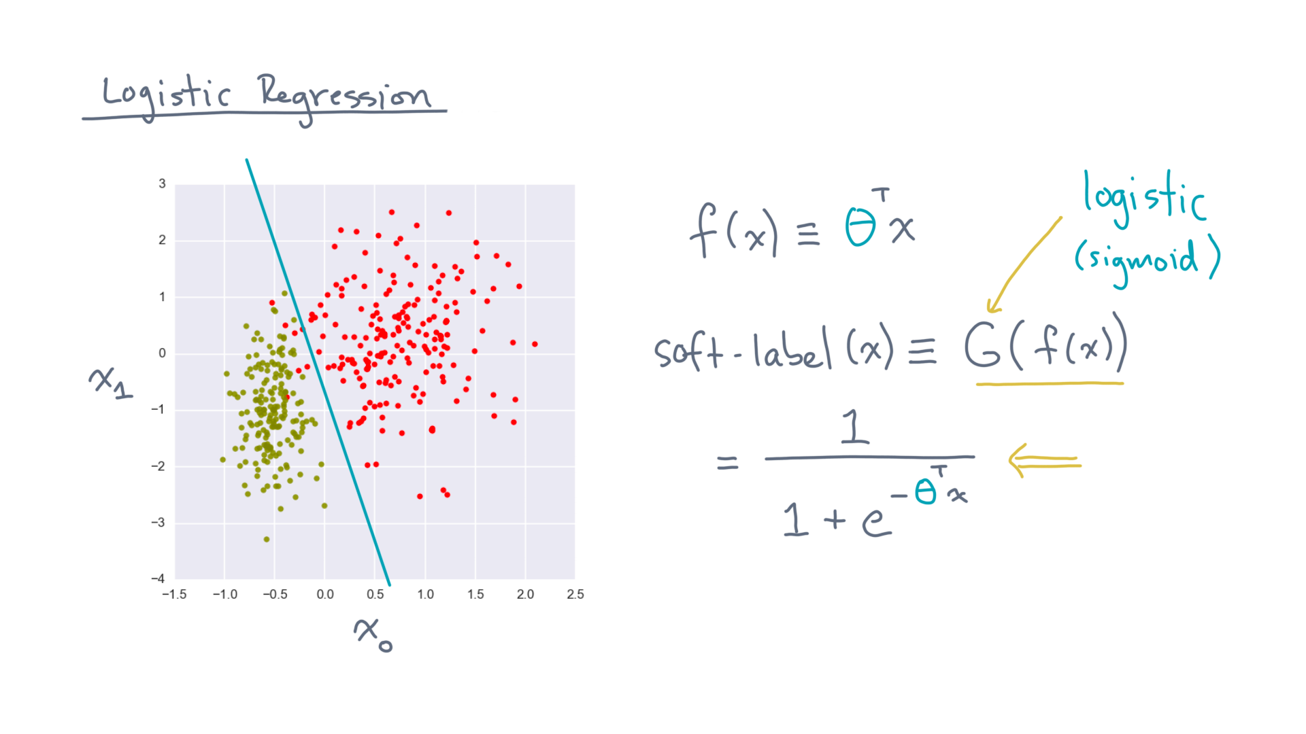
Notes:
To get labels for classification, you put the score through the logistic function.

Slide 6
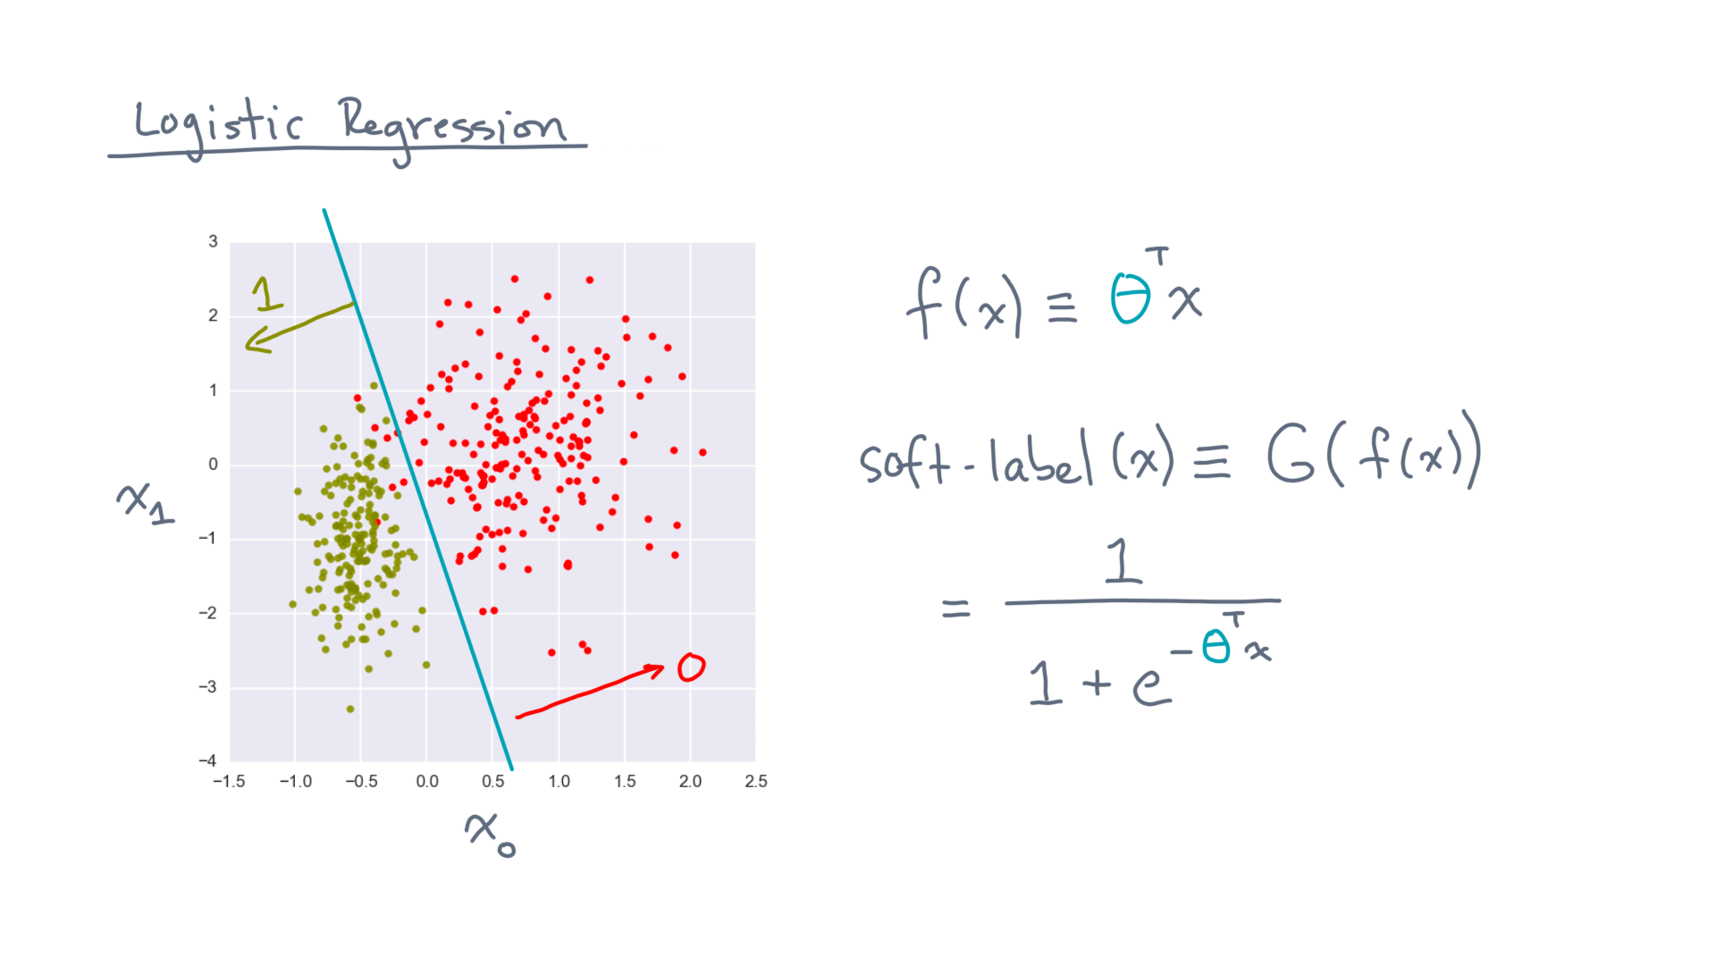
Notes:
The net effect is to assign values between 0 and 1, depending on the distance of a point from the boundary.

Slide 7
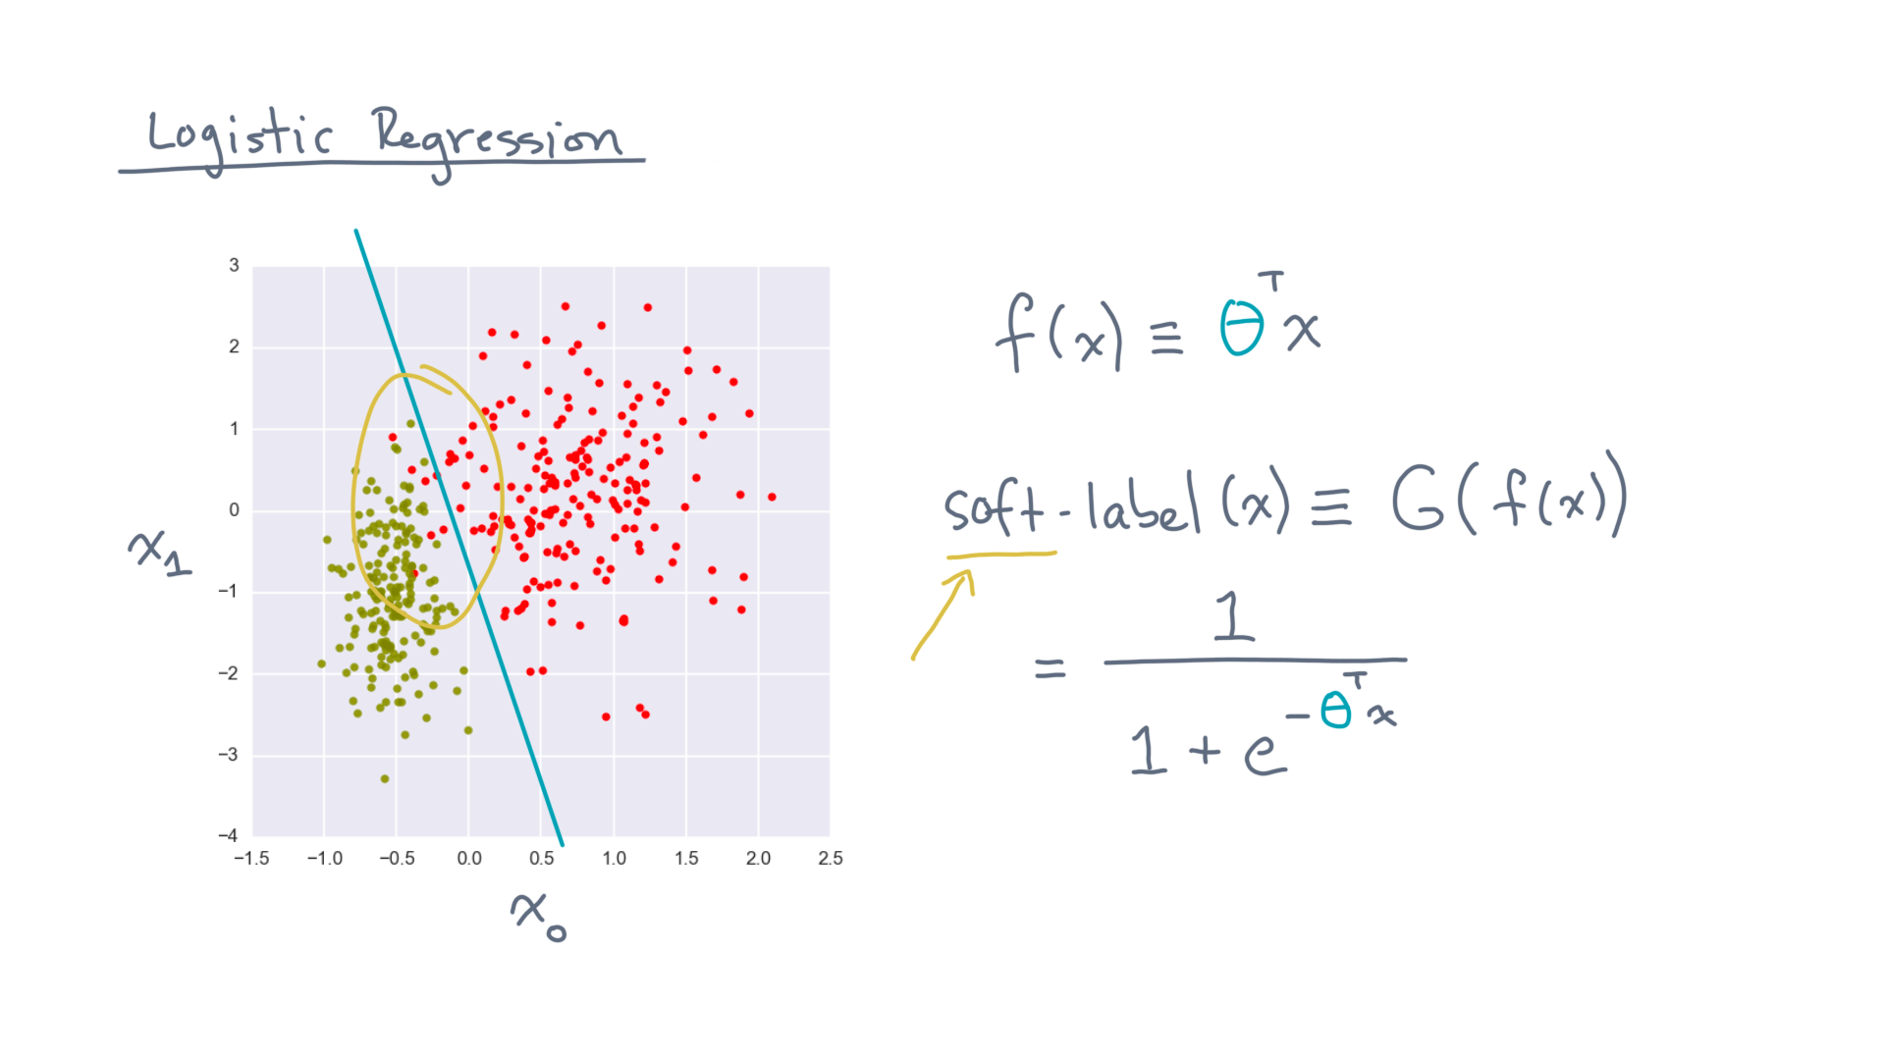
Notes:
The motivation for a “soft” assignment is the fact that real world data is often not cleanly separable.

Slide 8
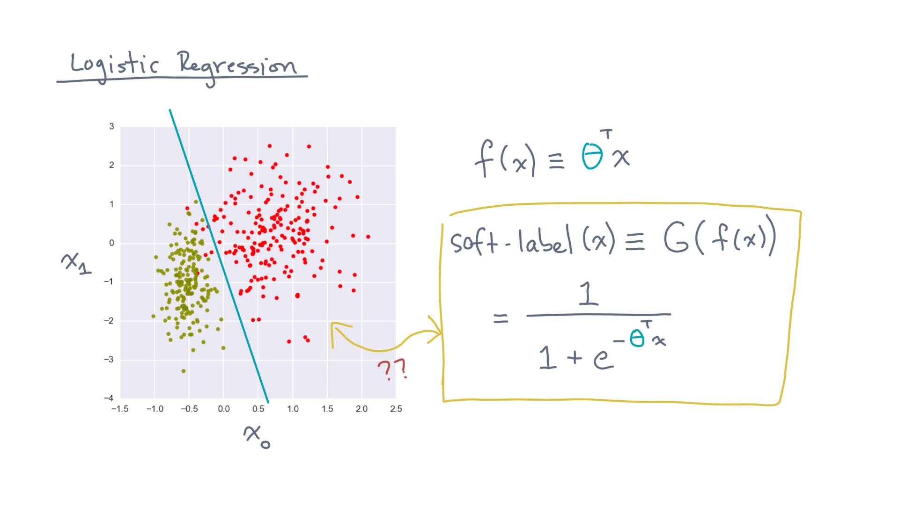
Notes:
So how do you fit this model to these data?
That is, how do calculate theta?

Slide 9
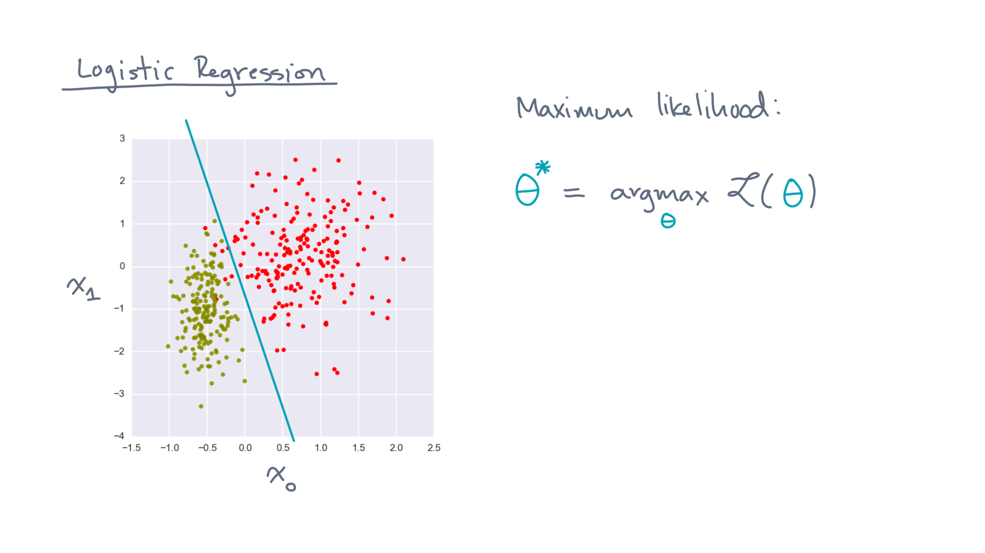
Notes:
Recall the maximum likelihood idea:

Slide 10
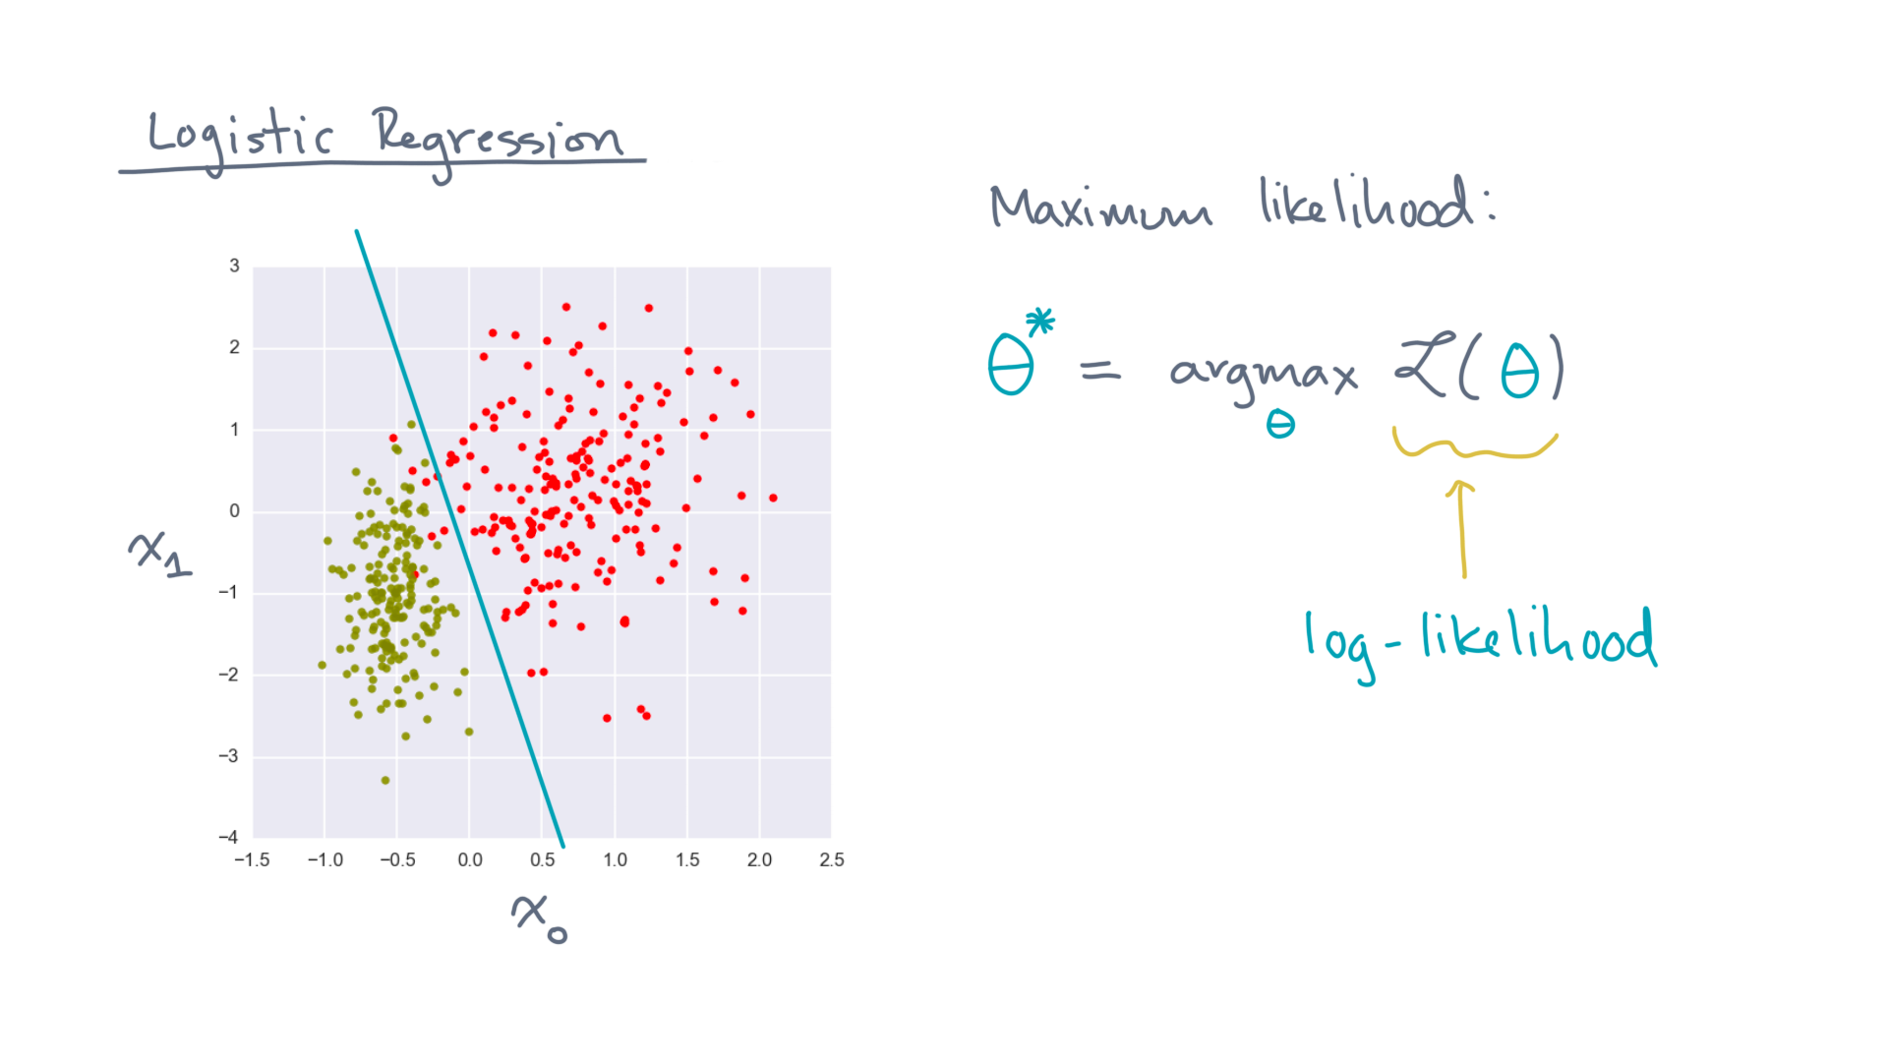
Notes:
Assume you can write down a function that measures how probable, or likely, the data are for a given theta.
One such function is the log-likelihood.

Slide 11
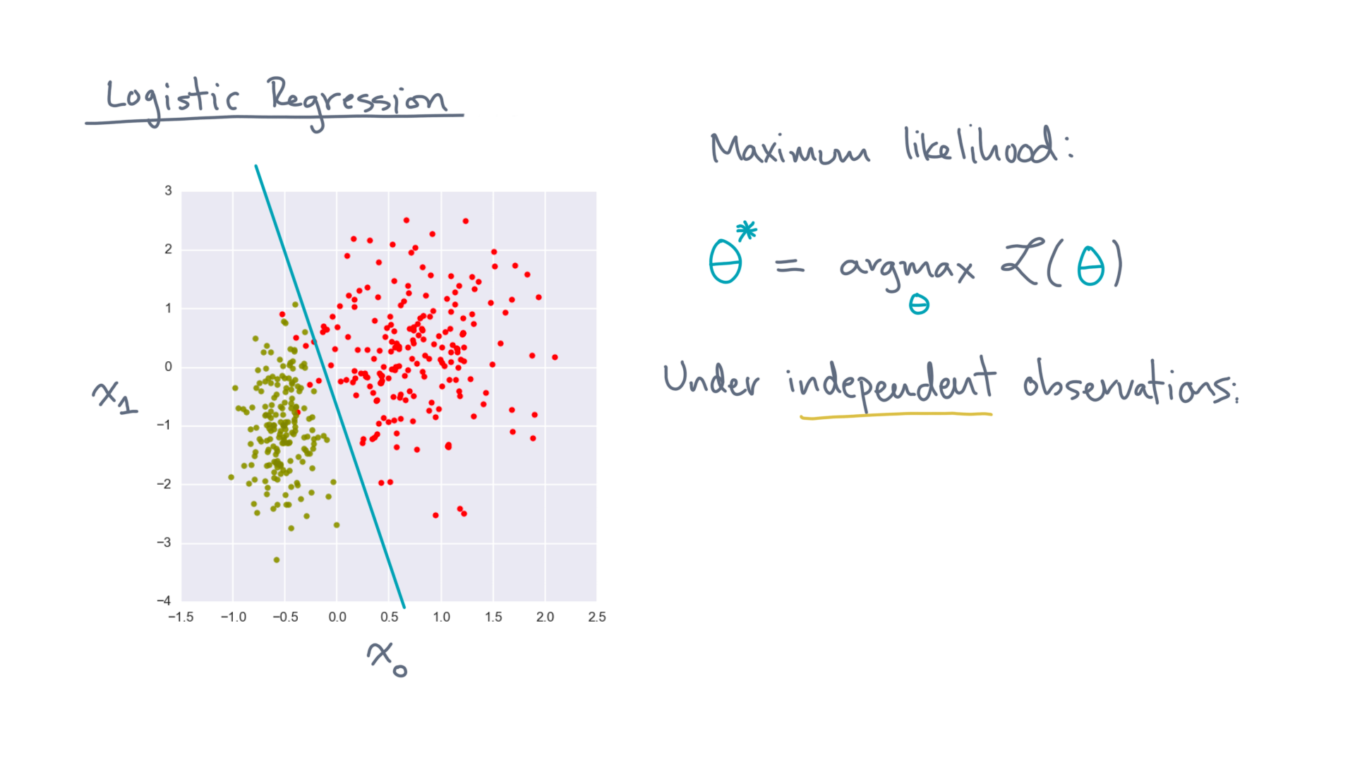
Notes:
Let’s further assume the observations are, themselves, *independent.*

Slide 12
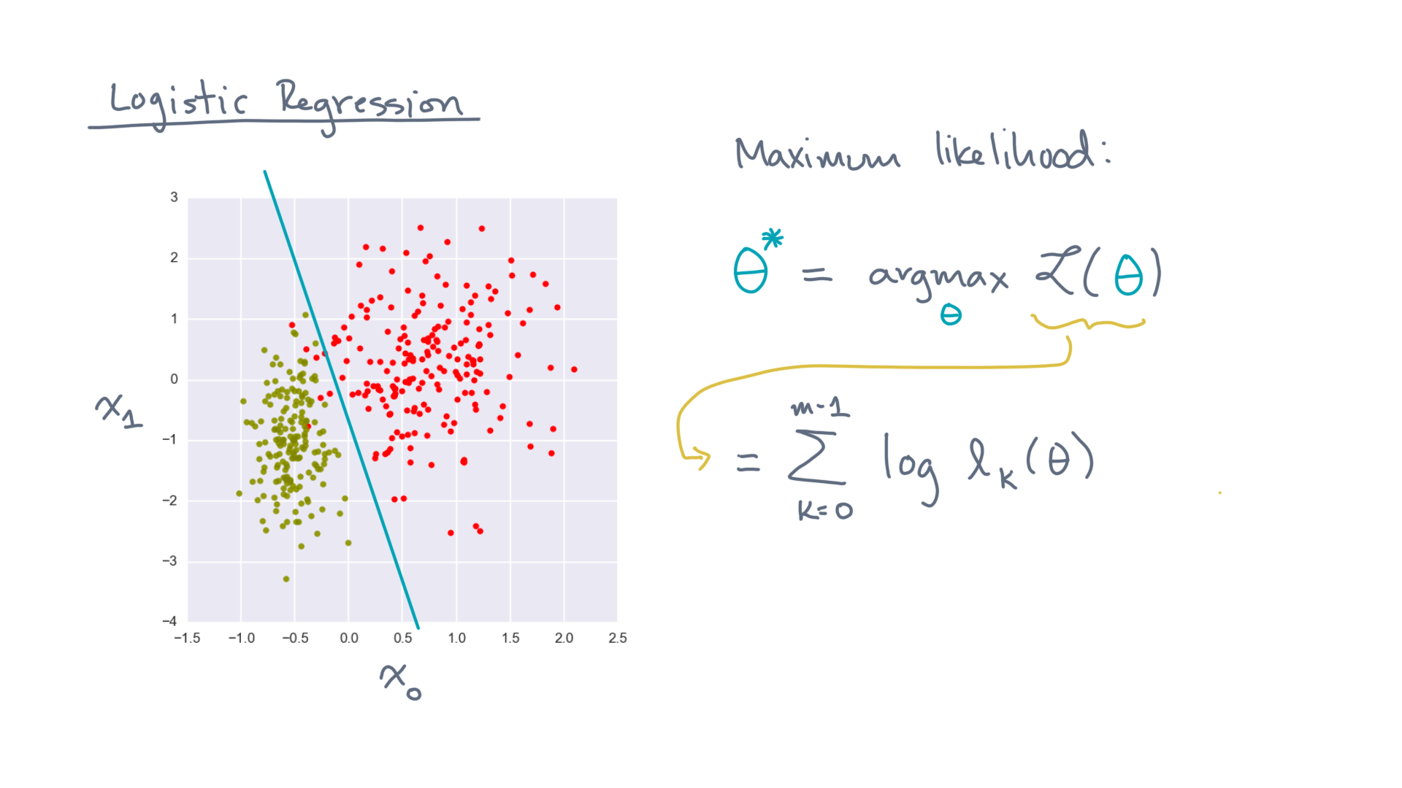
Notes:
Then the log-likelihood can be written as the sum of the log-likelihoods for each observation “kay”.
And recall that this little-ell-kay function is just the likelihood of an observation.

Slide 13
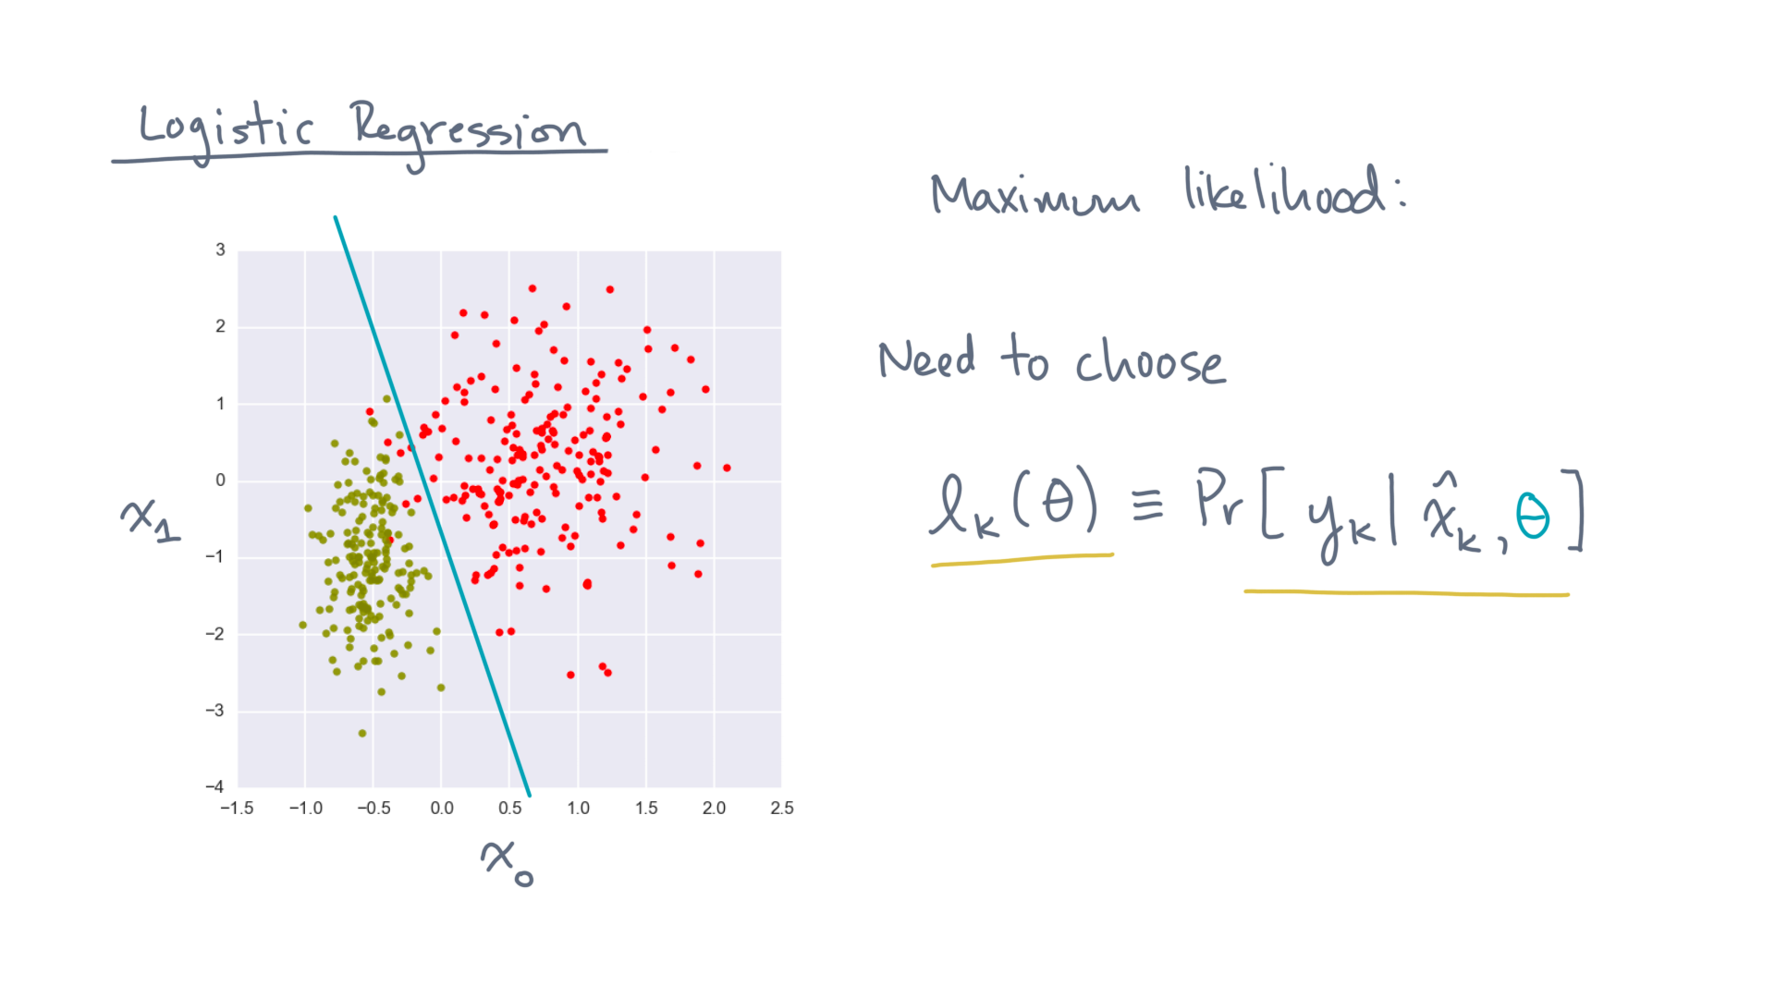
Notes:
That’s the conditional probability of the observed label, y-kay, given its coordinates, x-hat-kay, and theta.
So let’s determine this function now.

Slide 14
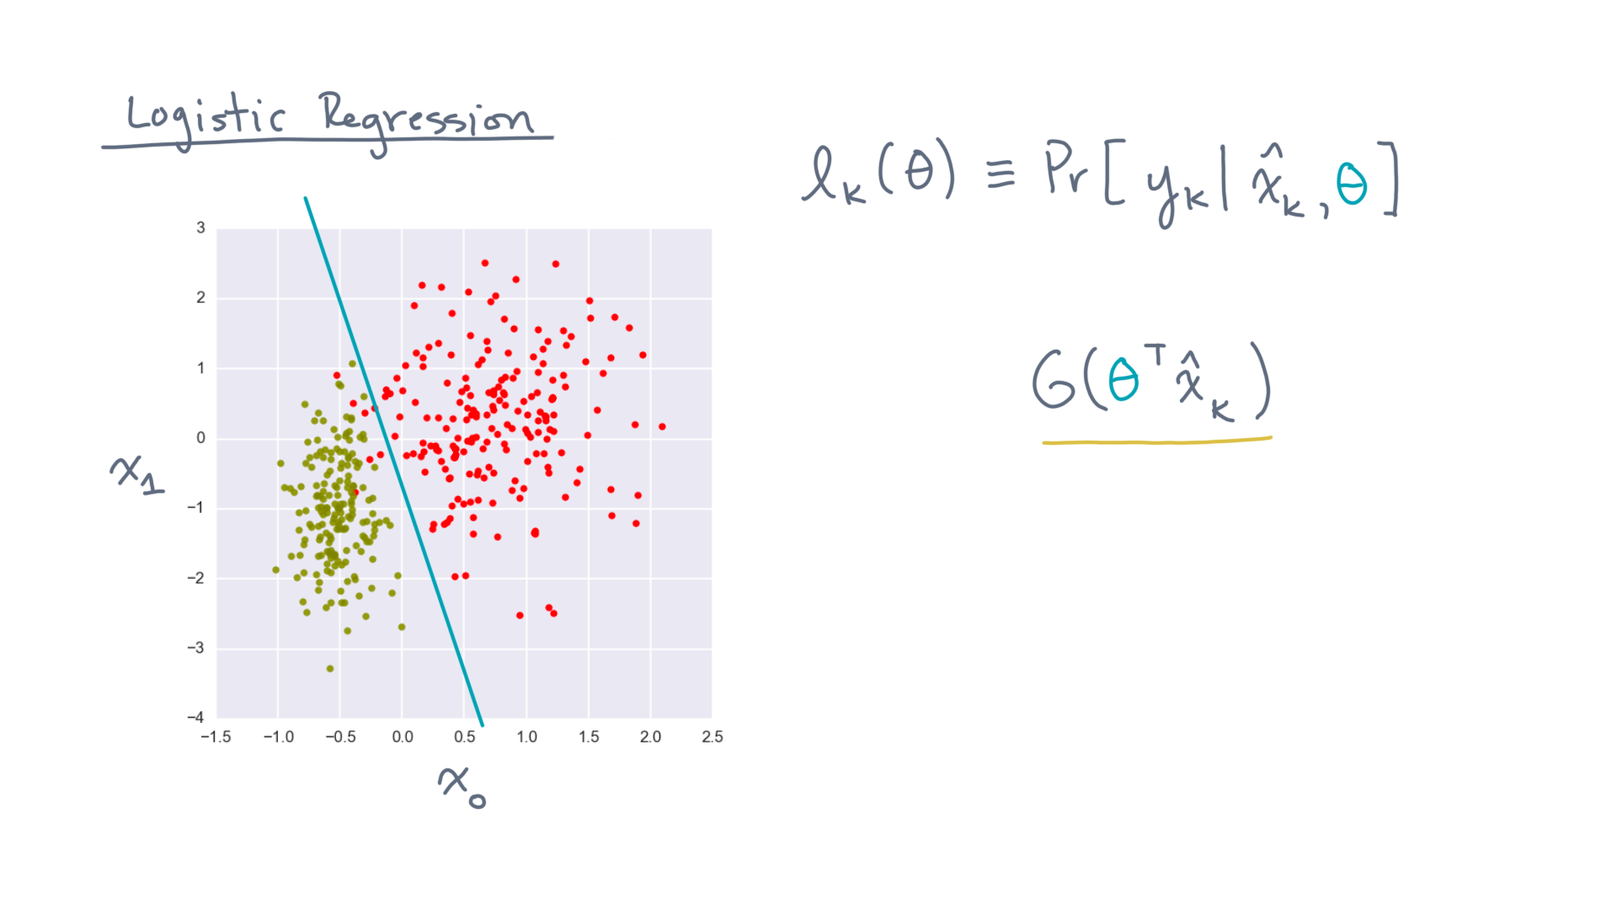
Notes:
Start with the logistic function with a linear boundary, G of theta-transpose-x-hat-kay.

Slide 15
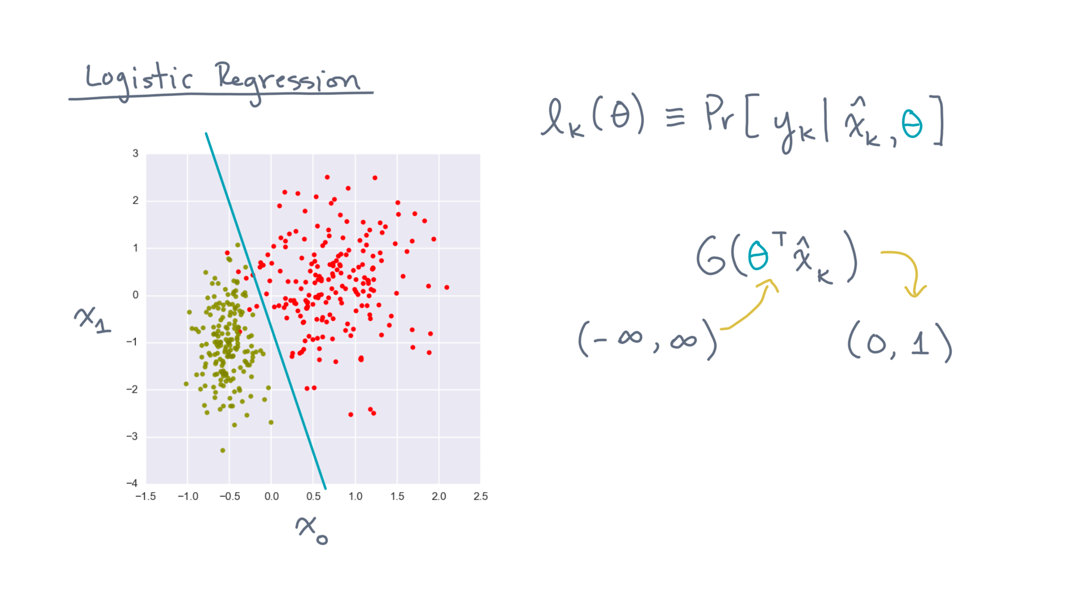
Notes:
Recall that it maps the real number line to the bounded interval, zero-one.
Therefore, it’s a function that we can try to interpret as a probability.

Slide 16
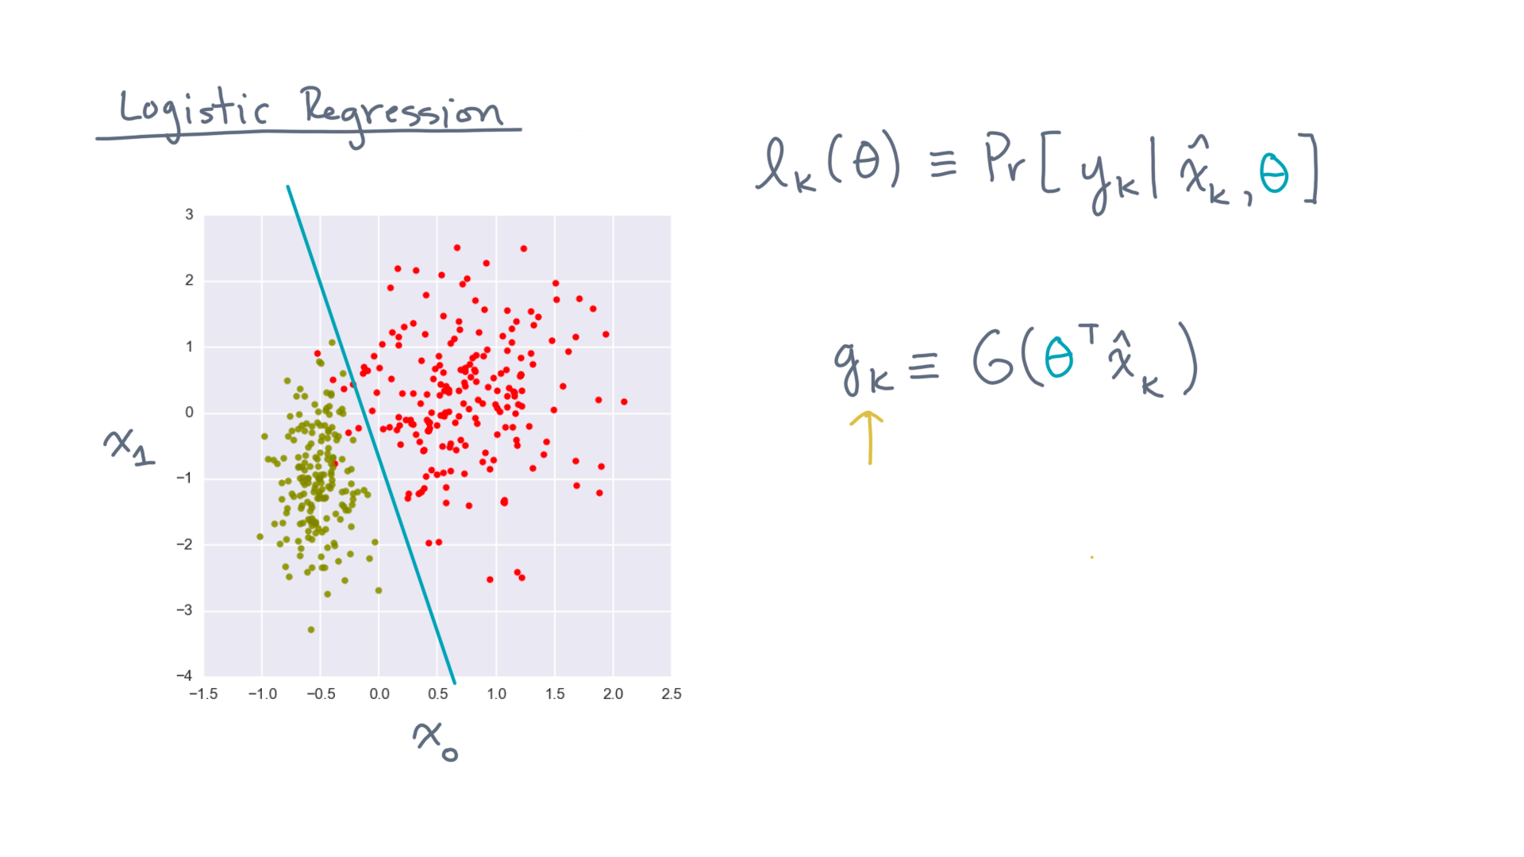
Notes:
Let’s call this little-gee-kay, for short.
Now, consider two cases:

Slide 17
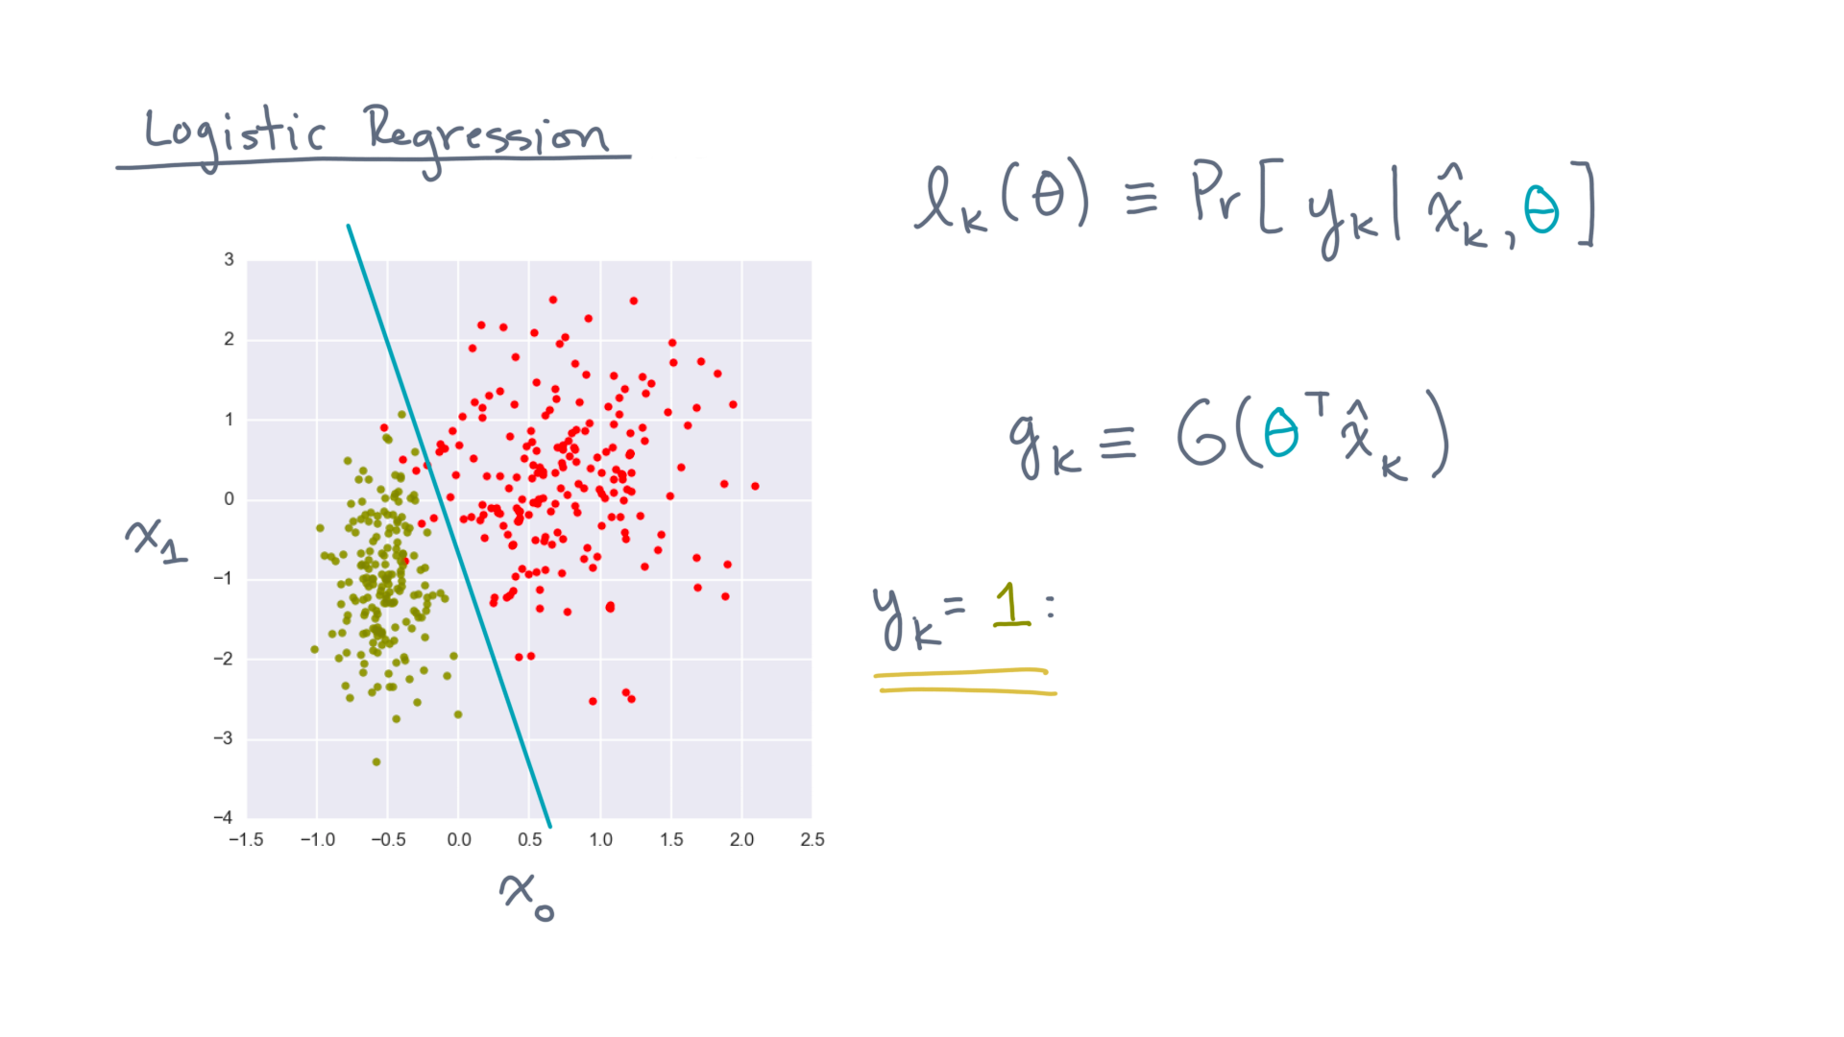
Notes:
First, suppose the observed label equals 1.

Slide 18
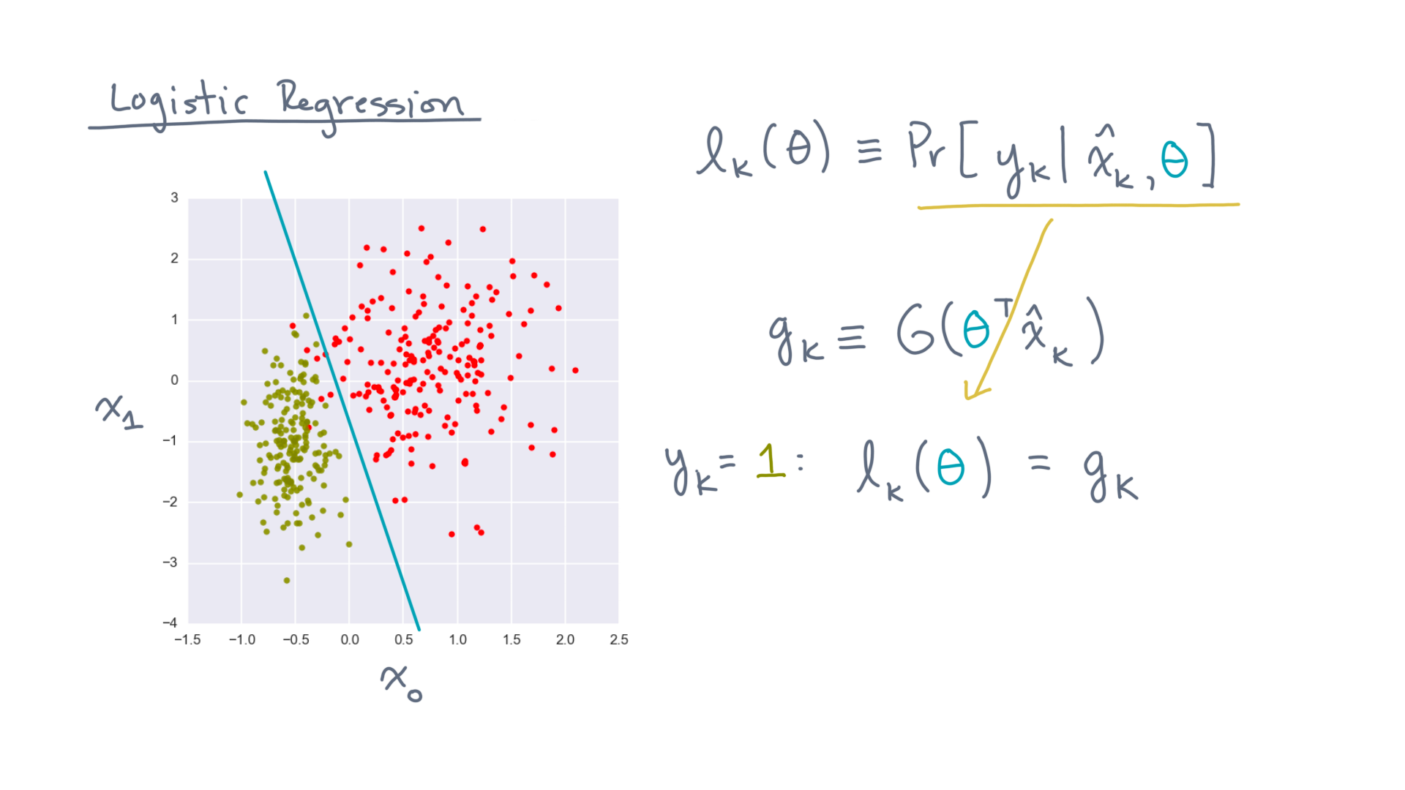
Notes:
Then we can define the probability of seeing this label, for a given model, as little-gee-kay.

Slide 19
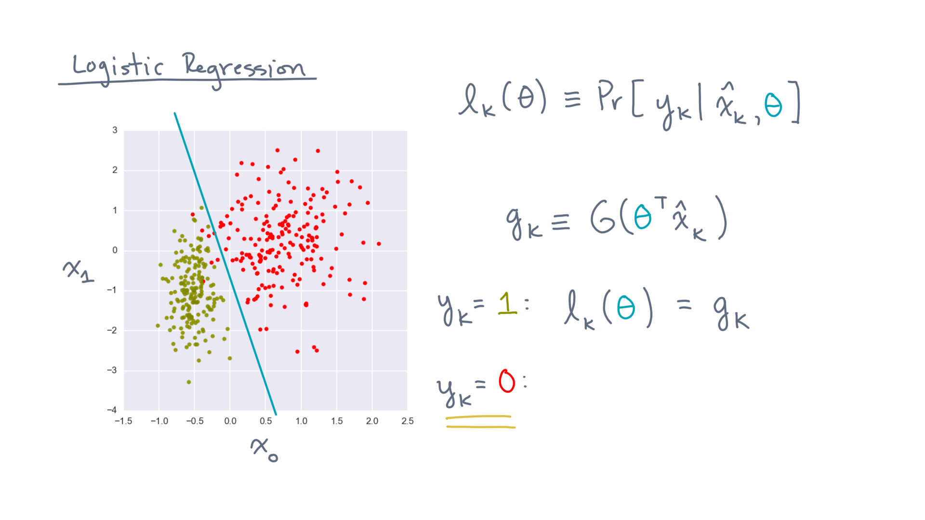
Notes:
What if, instead, the observed label is zero?

Slide 20
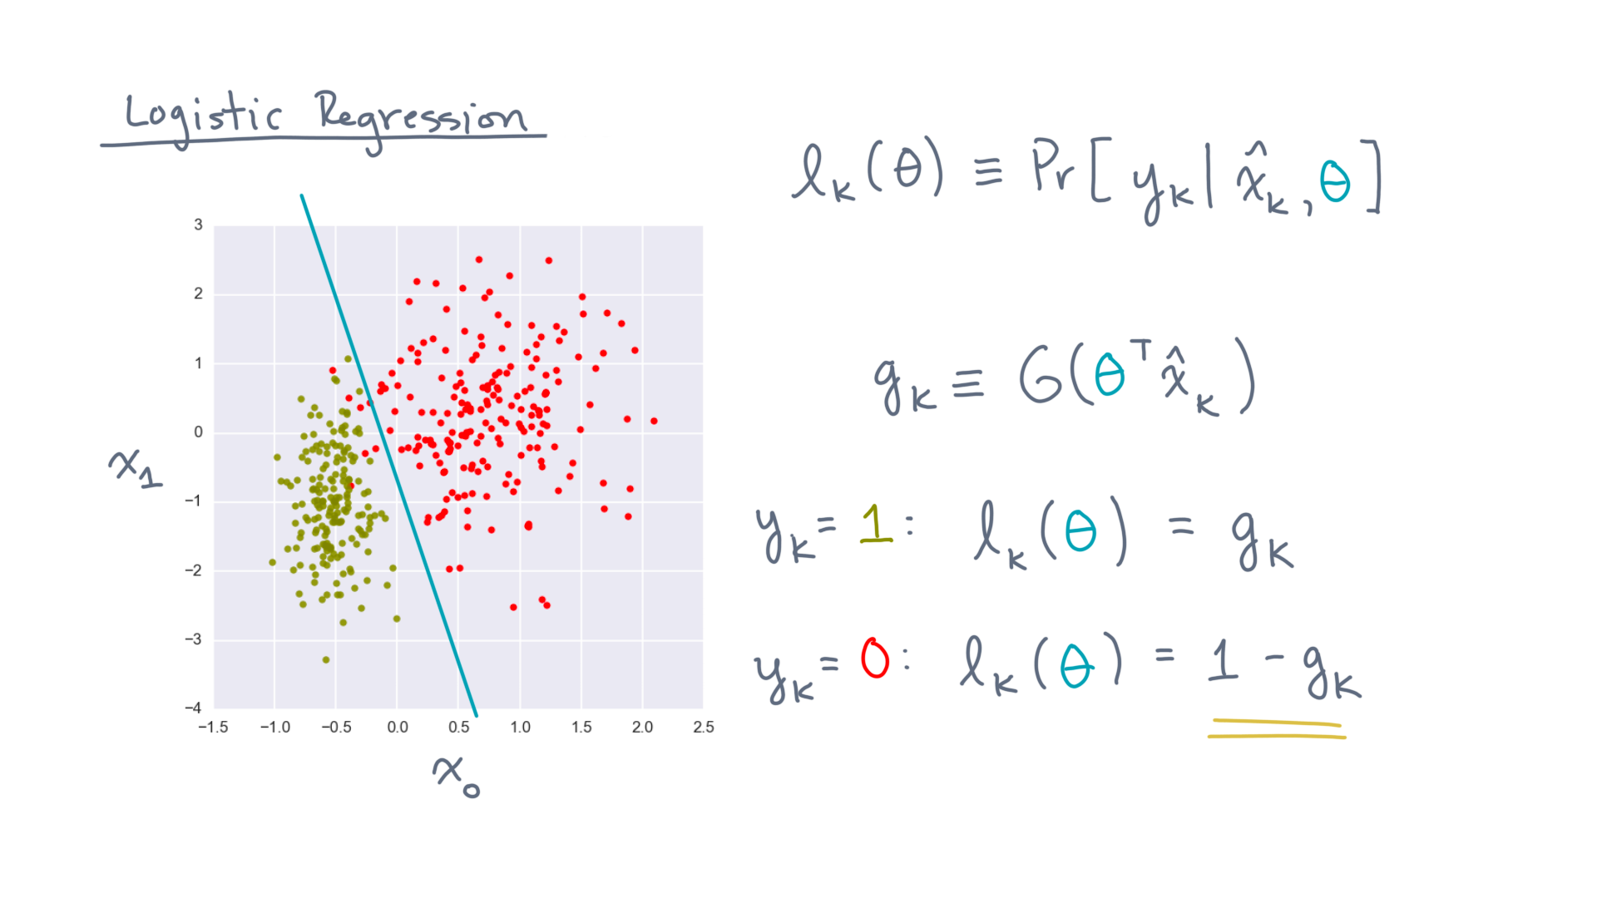
Notes:
Then its probability under this model must be one *minus* little-gee-kay.

Slide 21
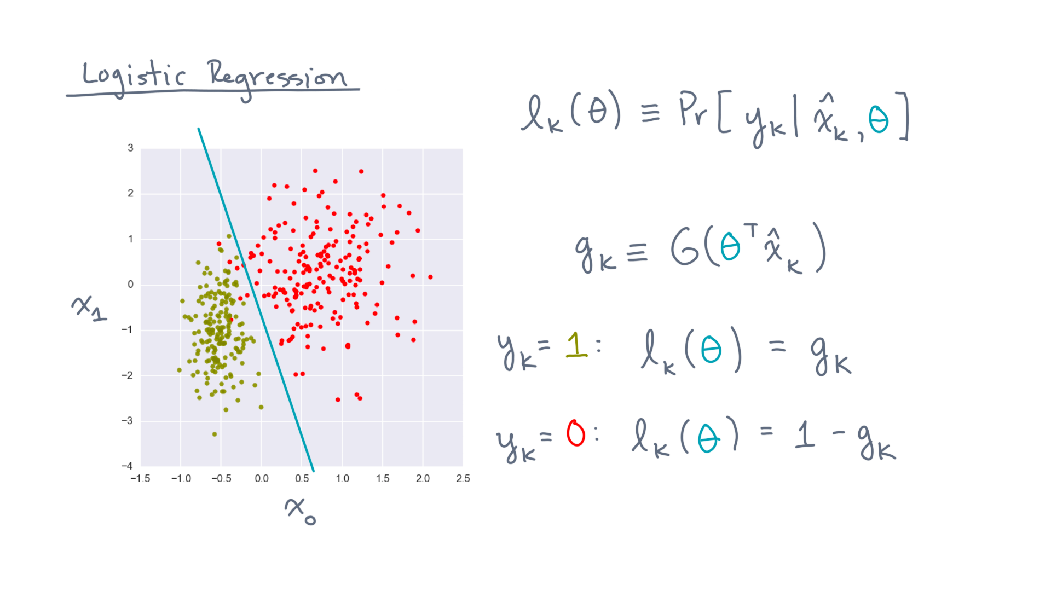
Notes:
Now, there is a little trick to combine these cases into a single formula:

Slide 22
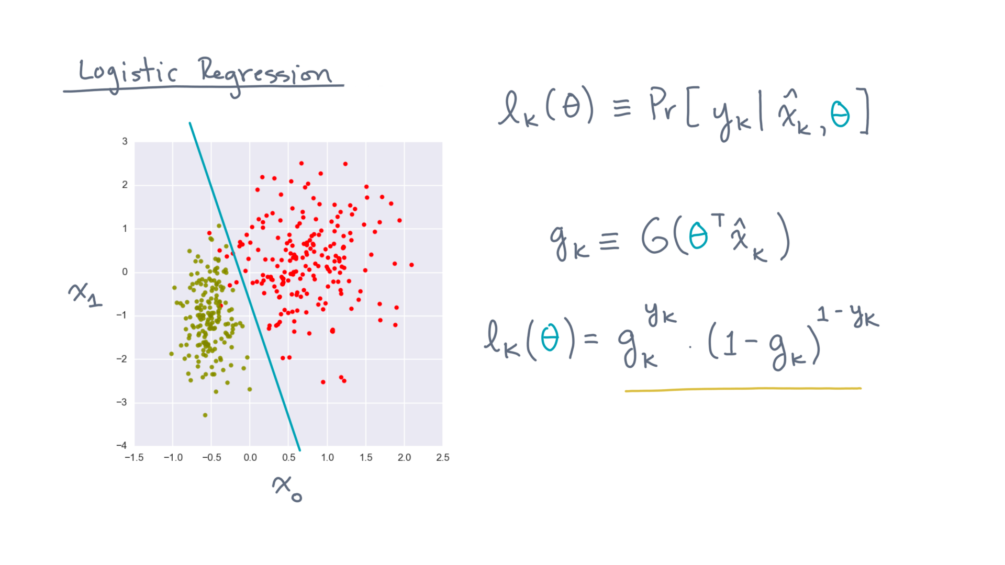
Notes:
The result is gee-kay to the power y-kay, times (one minus gee-kay) to the power (one minus y-kay).
We are using the fact that y-kay is either 0 or 1 to implement a “mathematical if statement.”

Slide 23
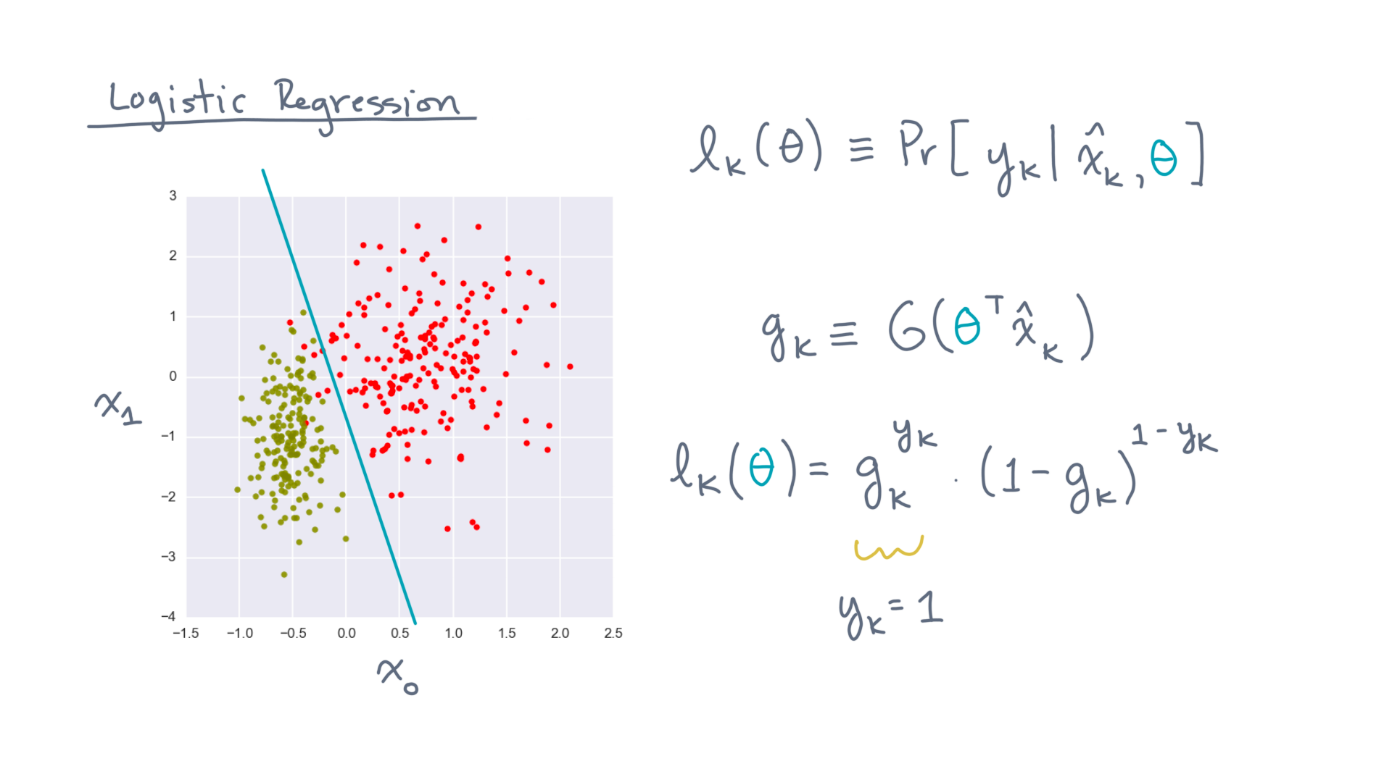
Notes:
The first term corresponds to the observed label being one.
When it’s zero, this term is just one and so effectively ignored.

Slide 24
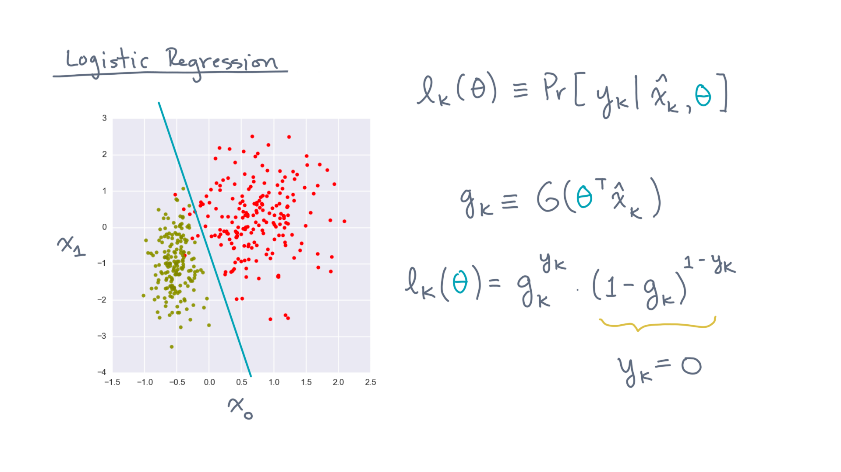
Notes:
The second term is for a label of zero, and is ignored if the label is instead one.

Slide 25
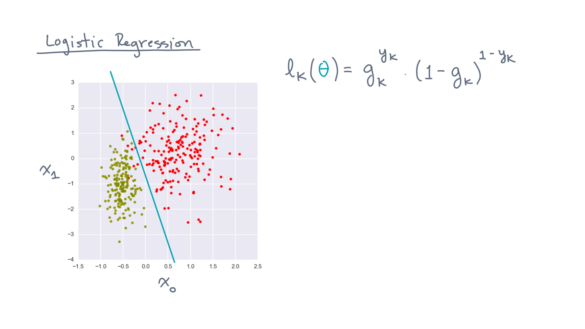
Notes:
This form is especially convenient to the task at hand.
Why?

Slide 26
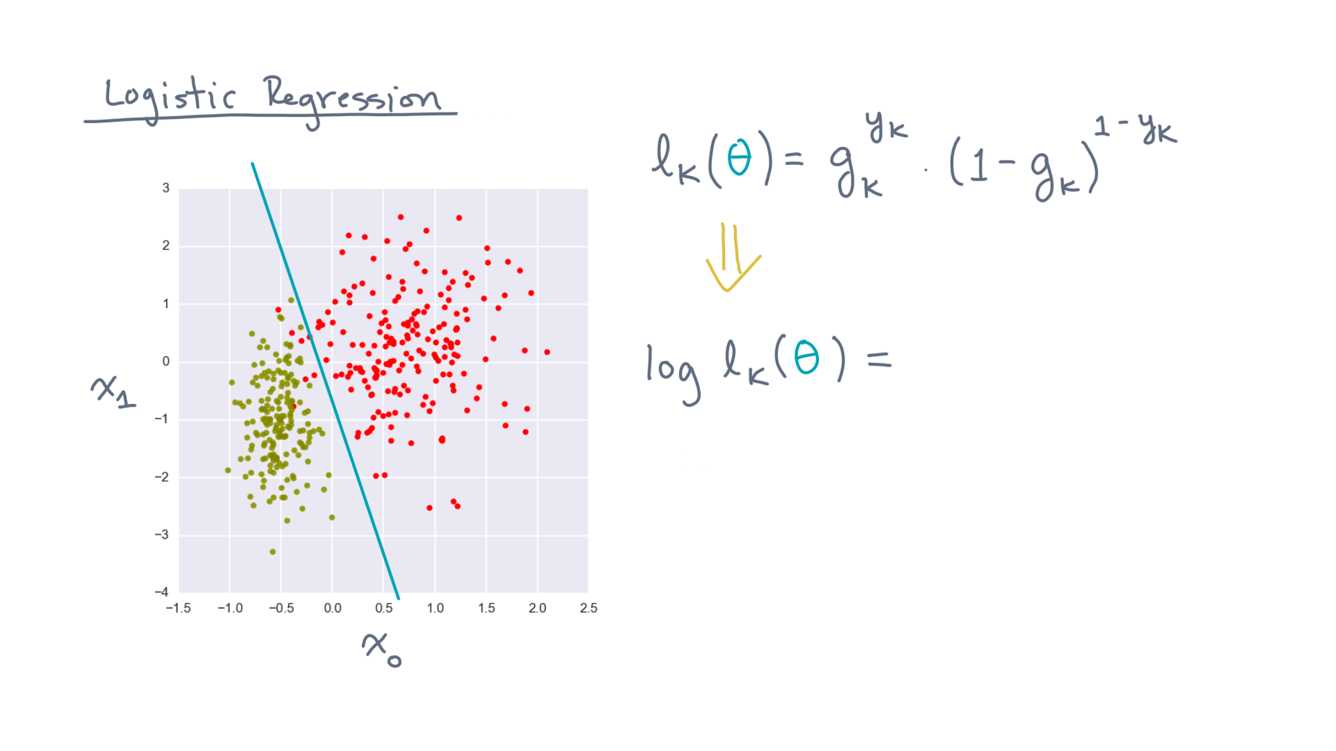
Notes:
First, taking logs of this function is easy.

Slide 27
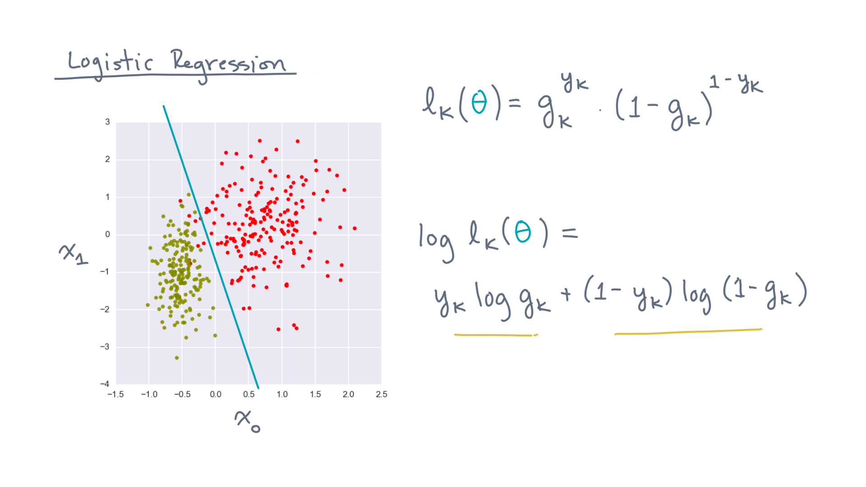
Notes:
It’s just y-kay times log gee-kay *plus* (one minus y-kay) times log (one minus gee-kay).

Slide 28
Notes:
Okay. Now, here’s the second reason this form is convenient.

Slide 29
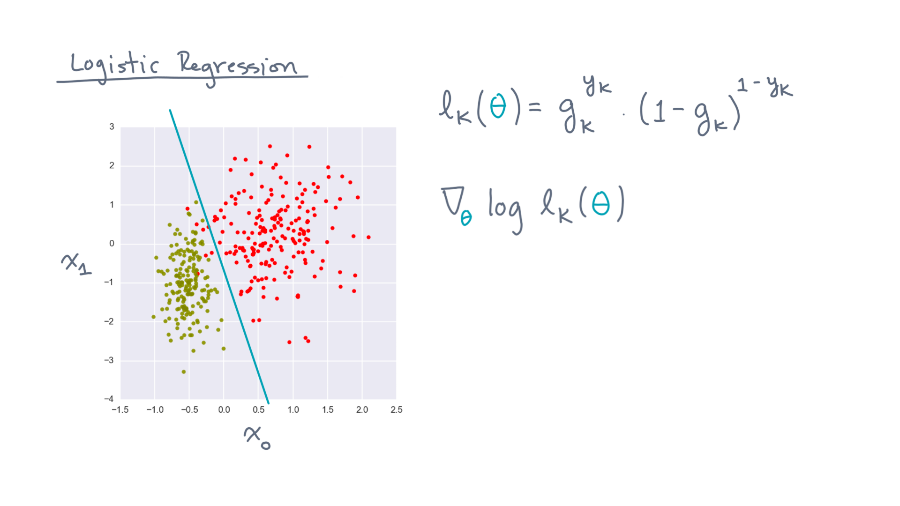
Notes:
To find the maximum, you will eventually need to compute the gradient of the log-likelihood.

Slide 30
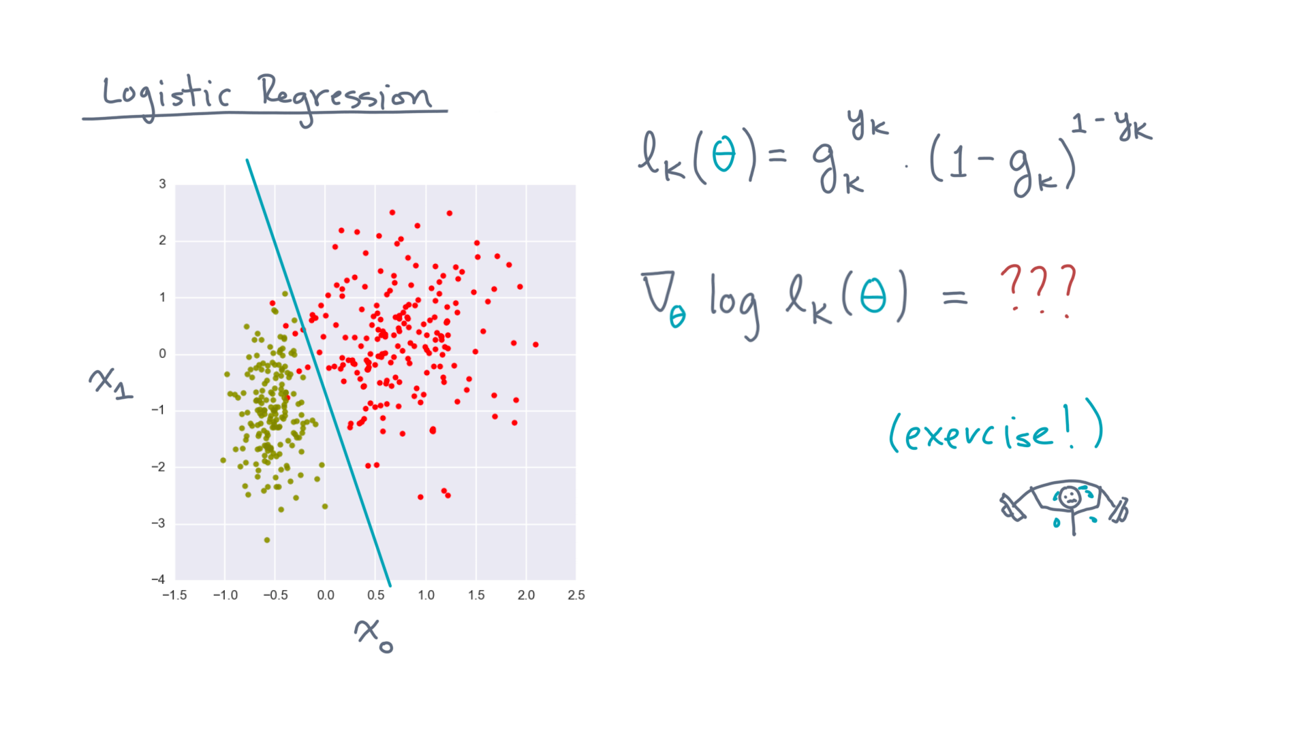
Notes:
As an exercise, you should try calculating it on your own.

Slide 31
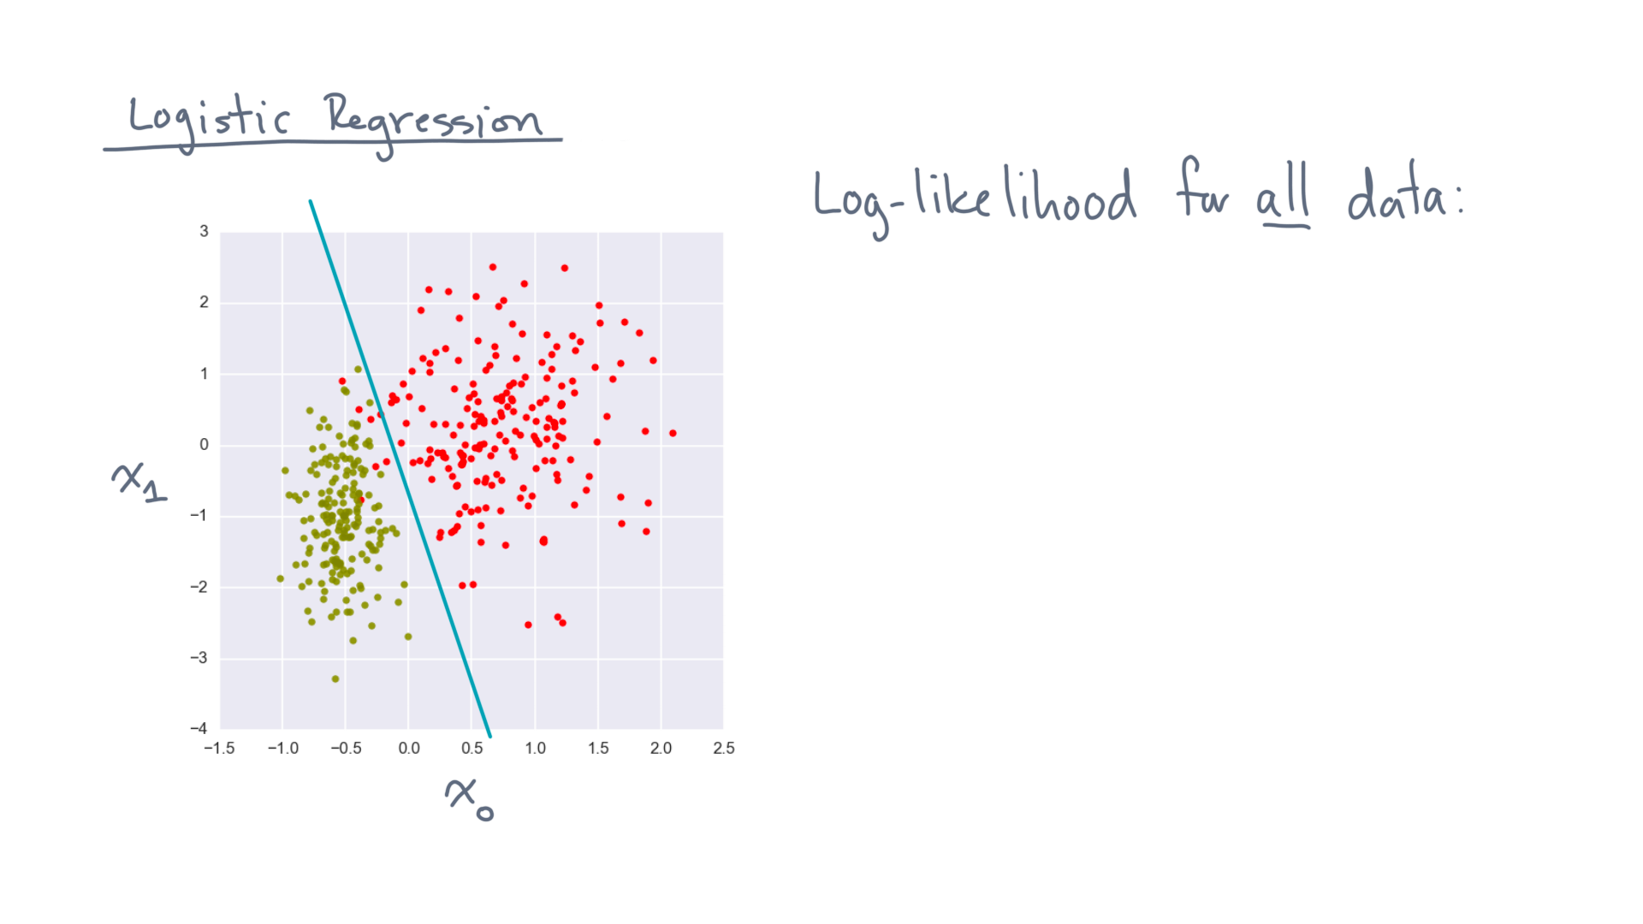
Notes:
Let’s close with one final observation.
There are some nice linear algebraic formulas for the log-likelihood over *all* the observations.

Slide 32
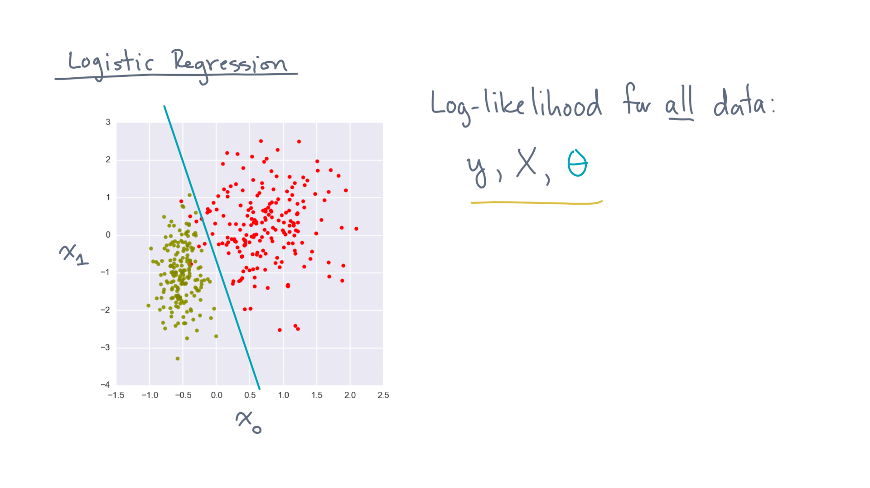
Notes:
Let y, X, and theta be our usual objects:
The vector of response labels, the data matrix of coordinates, and the vector of parameters.

Slide 33
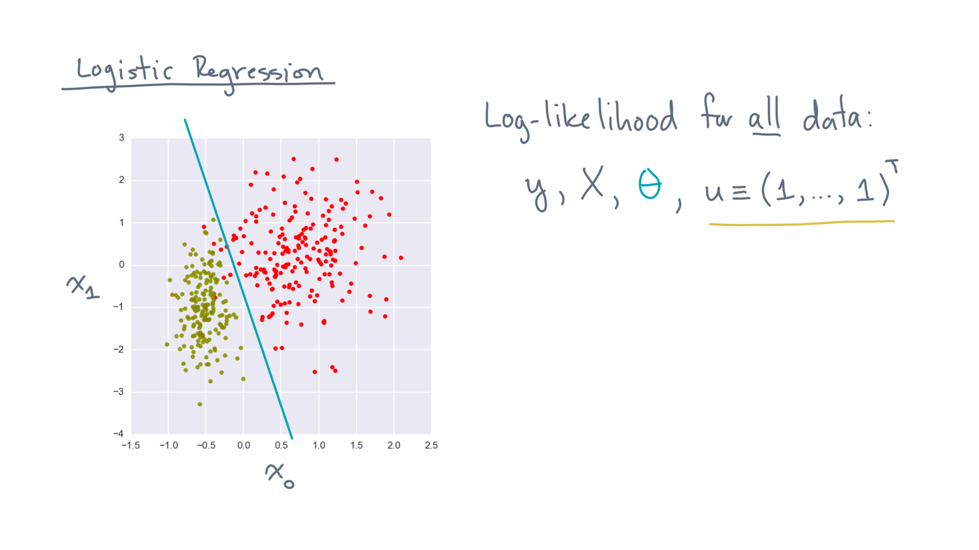
Notes:
Let’s also define “u” to be the vector of all ones.

Slide 34
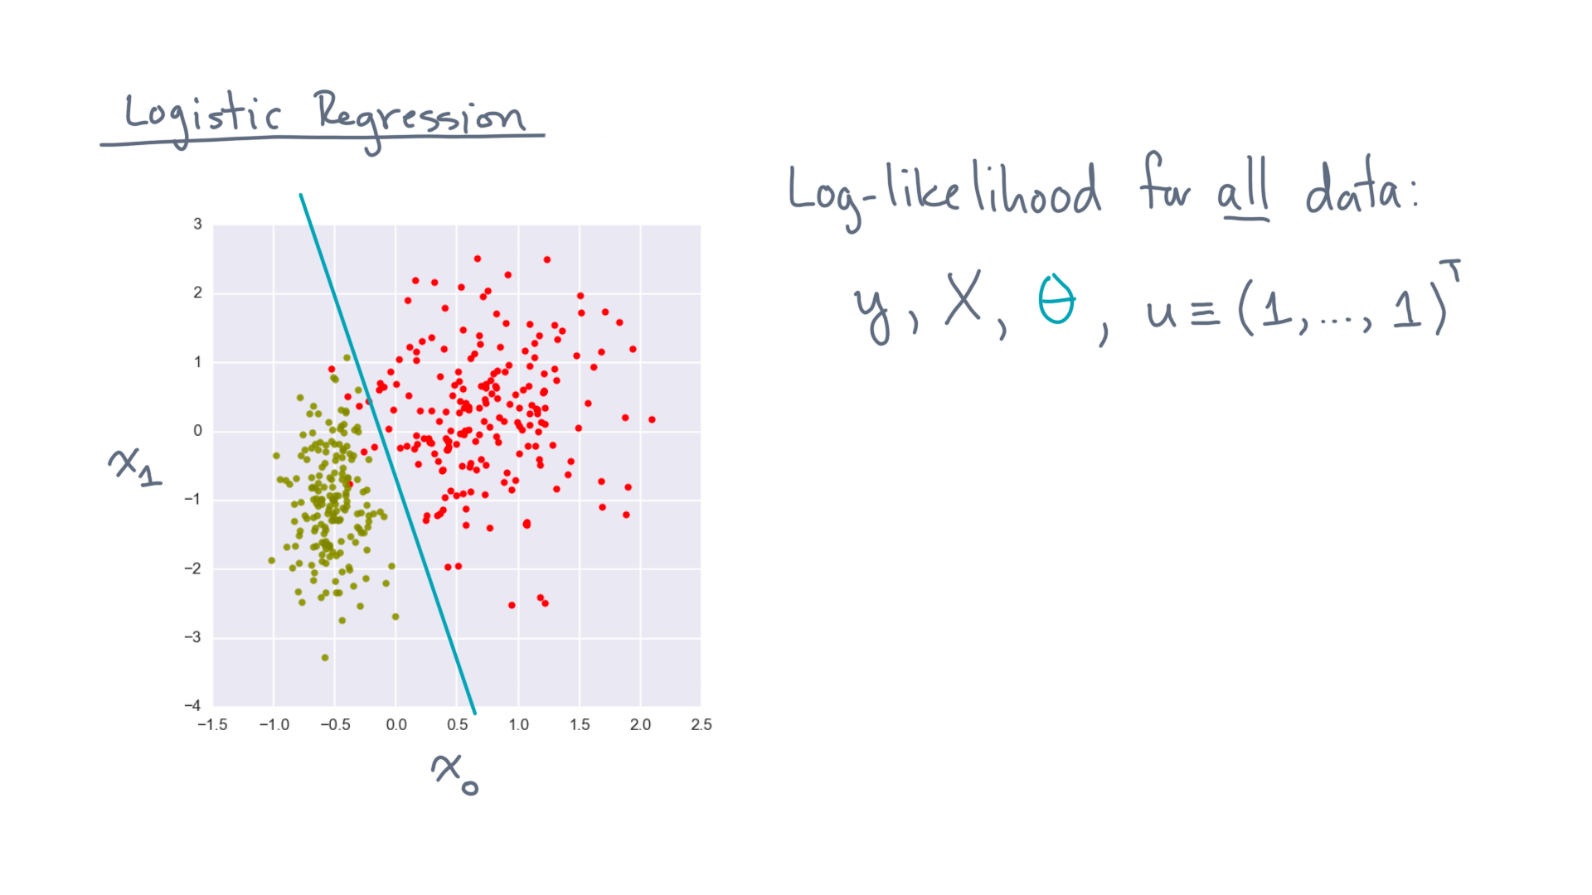
Notes:
Then, using all the mathematical tools at your disposal, you can show the following.

Slide 35
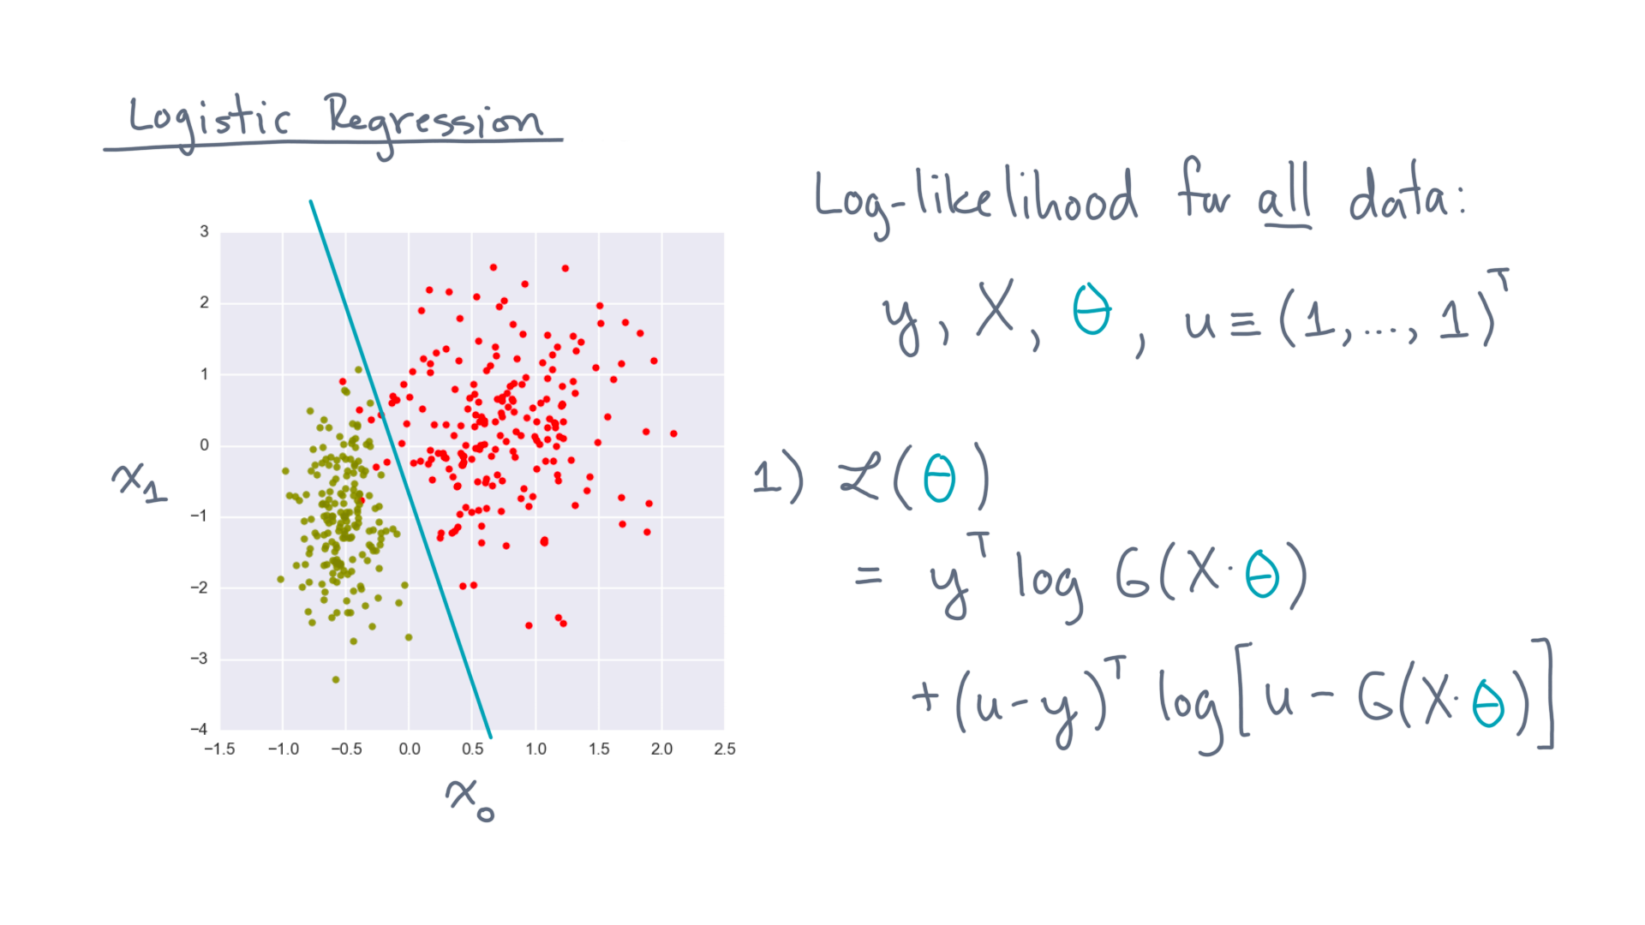
Notes:
First, one way to write the log-likelihood is through this formula.
Y-transpose times log of G of X times theta.
Plus, u minus y transpose times log of u minus G of X times theta.

Slide 36
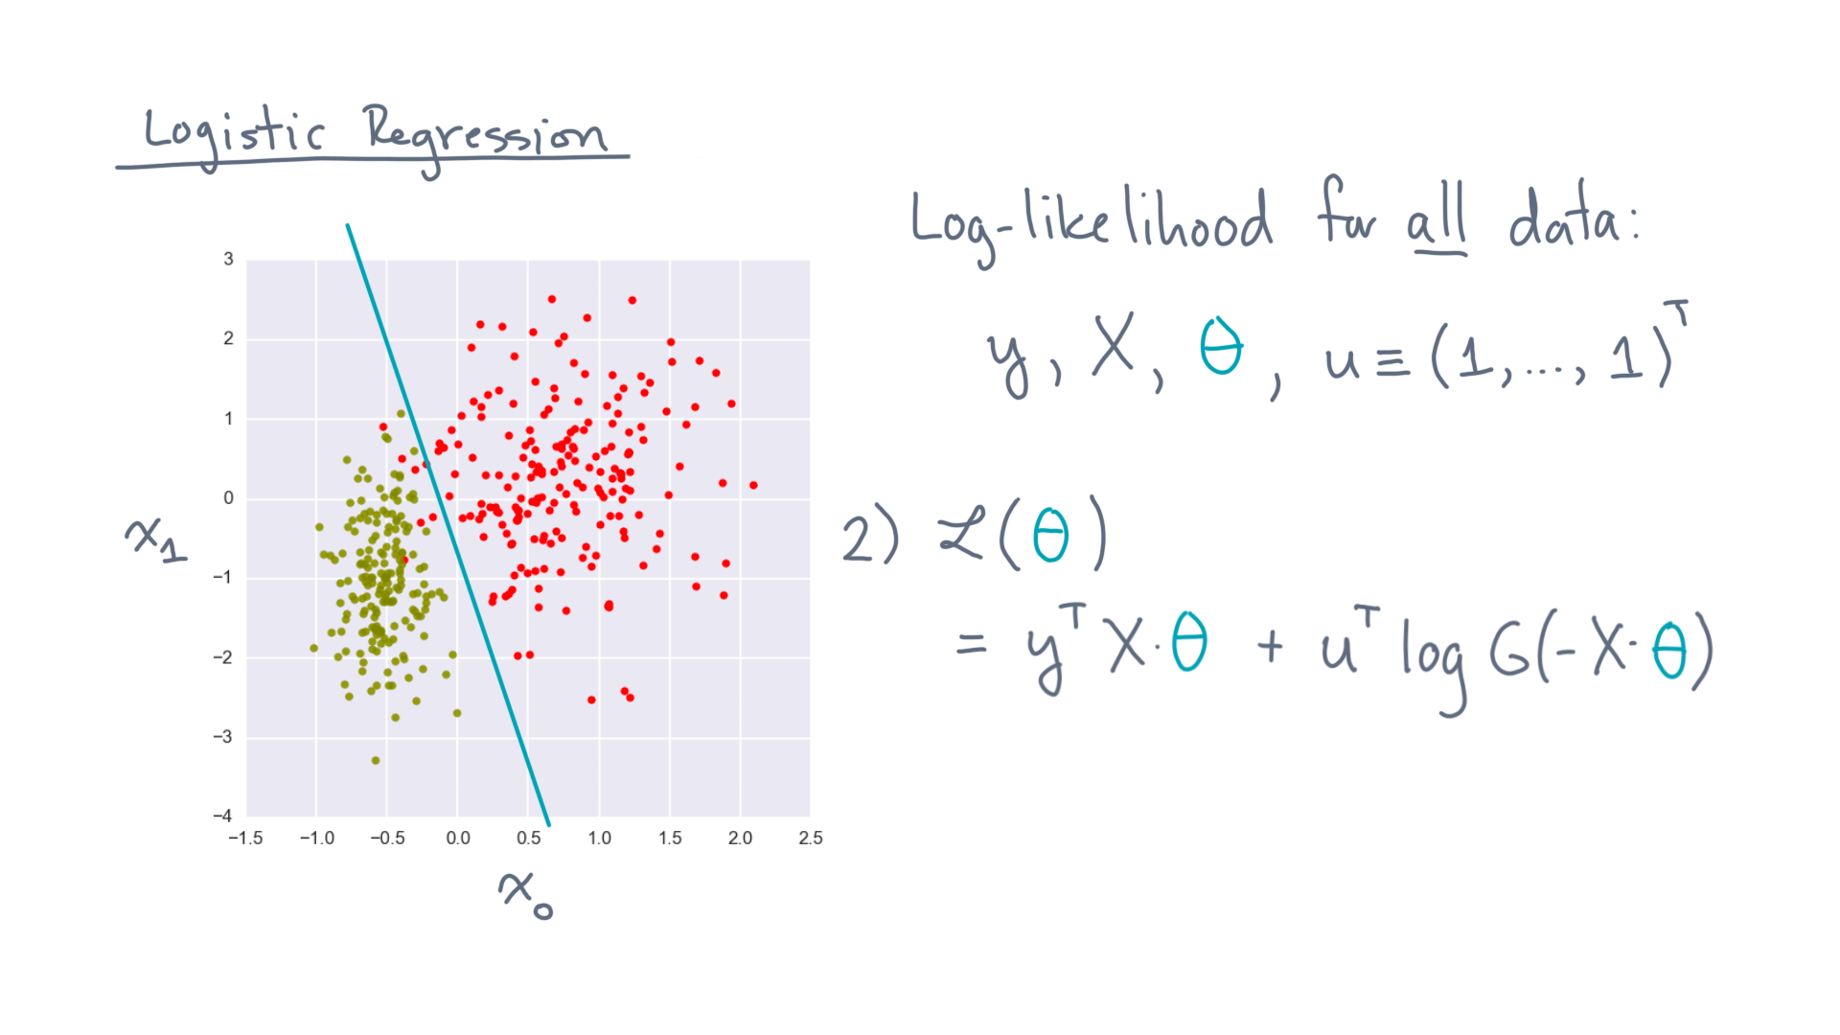
Notes:
Secondly, here is a slightly more compact formula:
Y-transpose-X-theta plus u-transpose-log of G of (minus X theta).

Slide 37
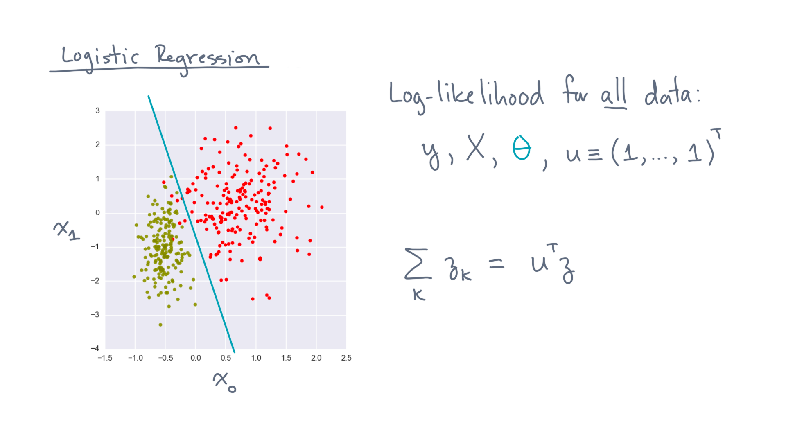
Notes:
One observation that these two formulas use is the fact that the sum of the elements of a vector, zee, is equal to u-transpose-times zee.
It’s a handy factoid for converting between scalar and vector formulas.

Slide 38
Notes:
To summarize, this lesson is about applying the mathematical framework of maximum likelihood estimation to the classification problem.
But MLE is a generic tool that you can apply in other settings.

Slide 39
Notes:
For instance, you can derive linear regression using MLE, which you might have seen in a separate course on regression.
The key step is coming up with a model for the likelihood.

Slide 40
Notes:
But there is a computational reason to go through this derivation, too.
You ended the lesson with the linear algebra formulas for calculating the log-likelihood, which will lead immediately to a reasonably efficient implementation.
The accompanying notebook exercises will walk you through that process, so go ahead and do those now, and I’ll see you when you’re done!

